Slide 1


Docling Get your documents ready for gen AI
IBM Research
–
Dr. Peter Staar Principal Research Staff, Manager | AI for Knowledge IBM Research – Europe
Dr. Michele Dolfi Senior Technical Staff Member | AI for Knowledge IBM Research – Europe
Join us tomorrow!
Docling Meetup 📅 Tuesday, May 20th, 6pm 📍 Location: MIT-IBM Watson AI Lab in Cambridge
Registration: https://ibm.biz/DoclingCommunity

Slide 2
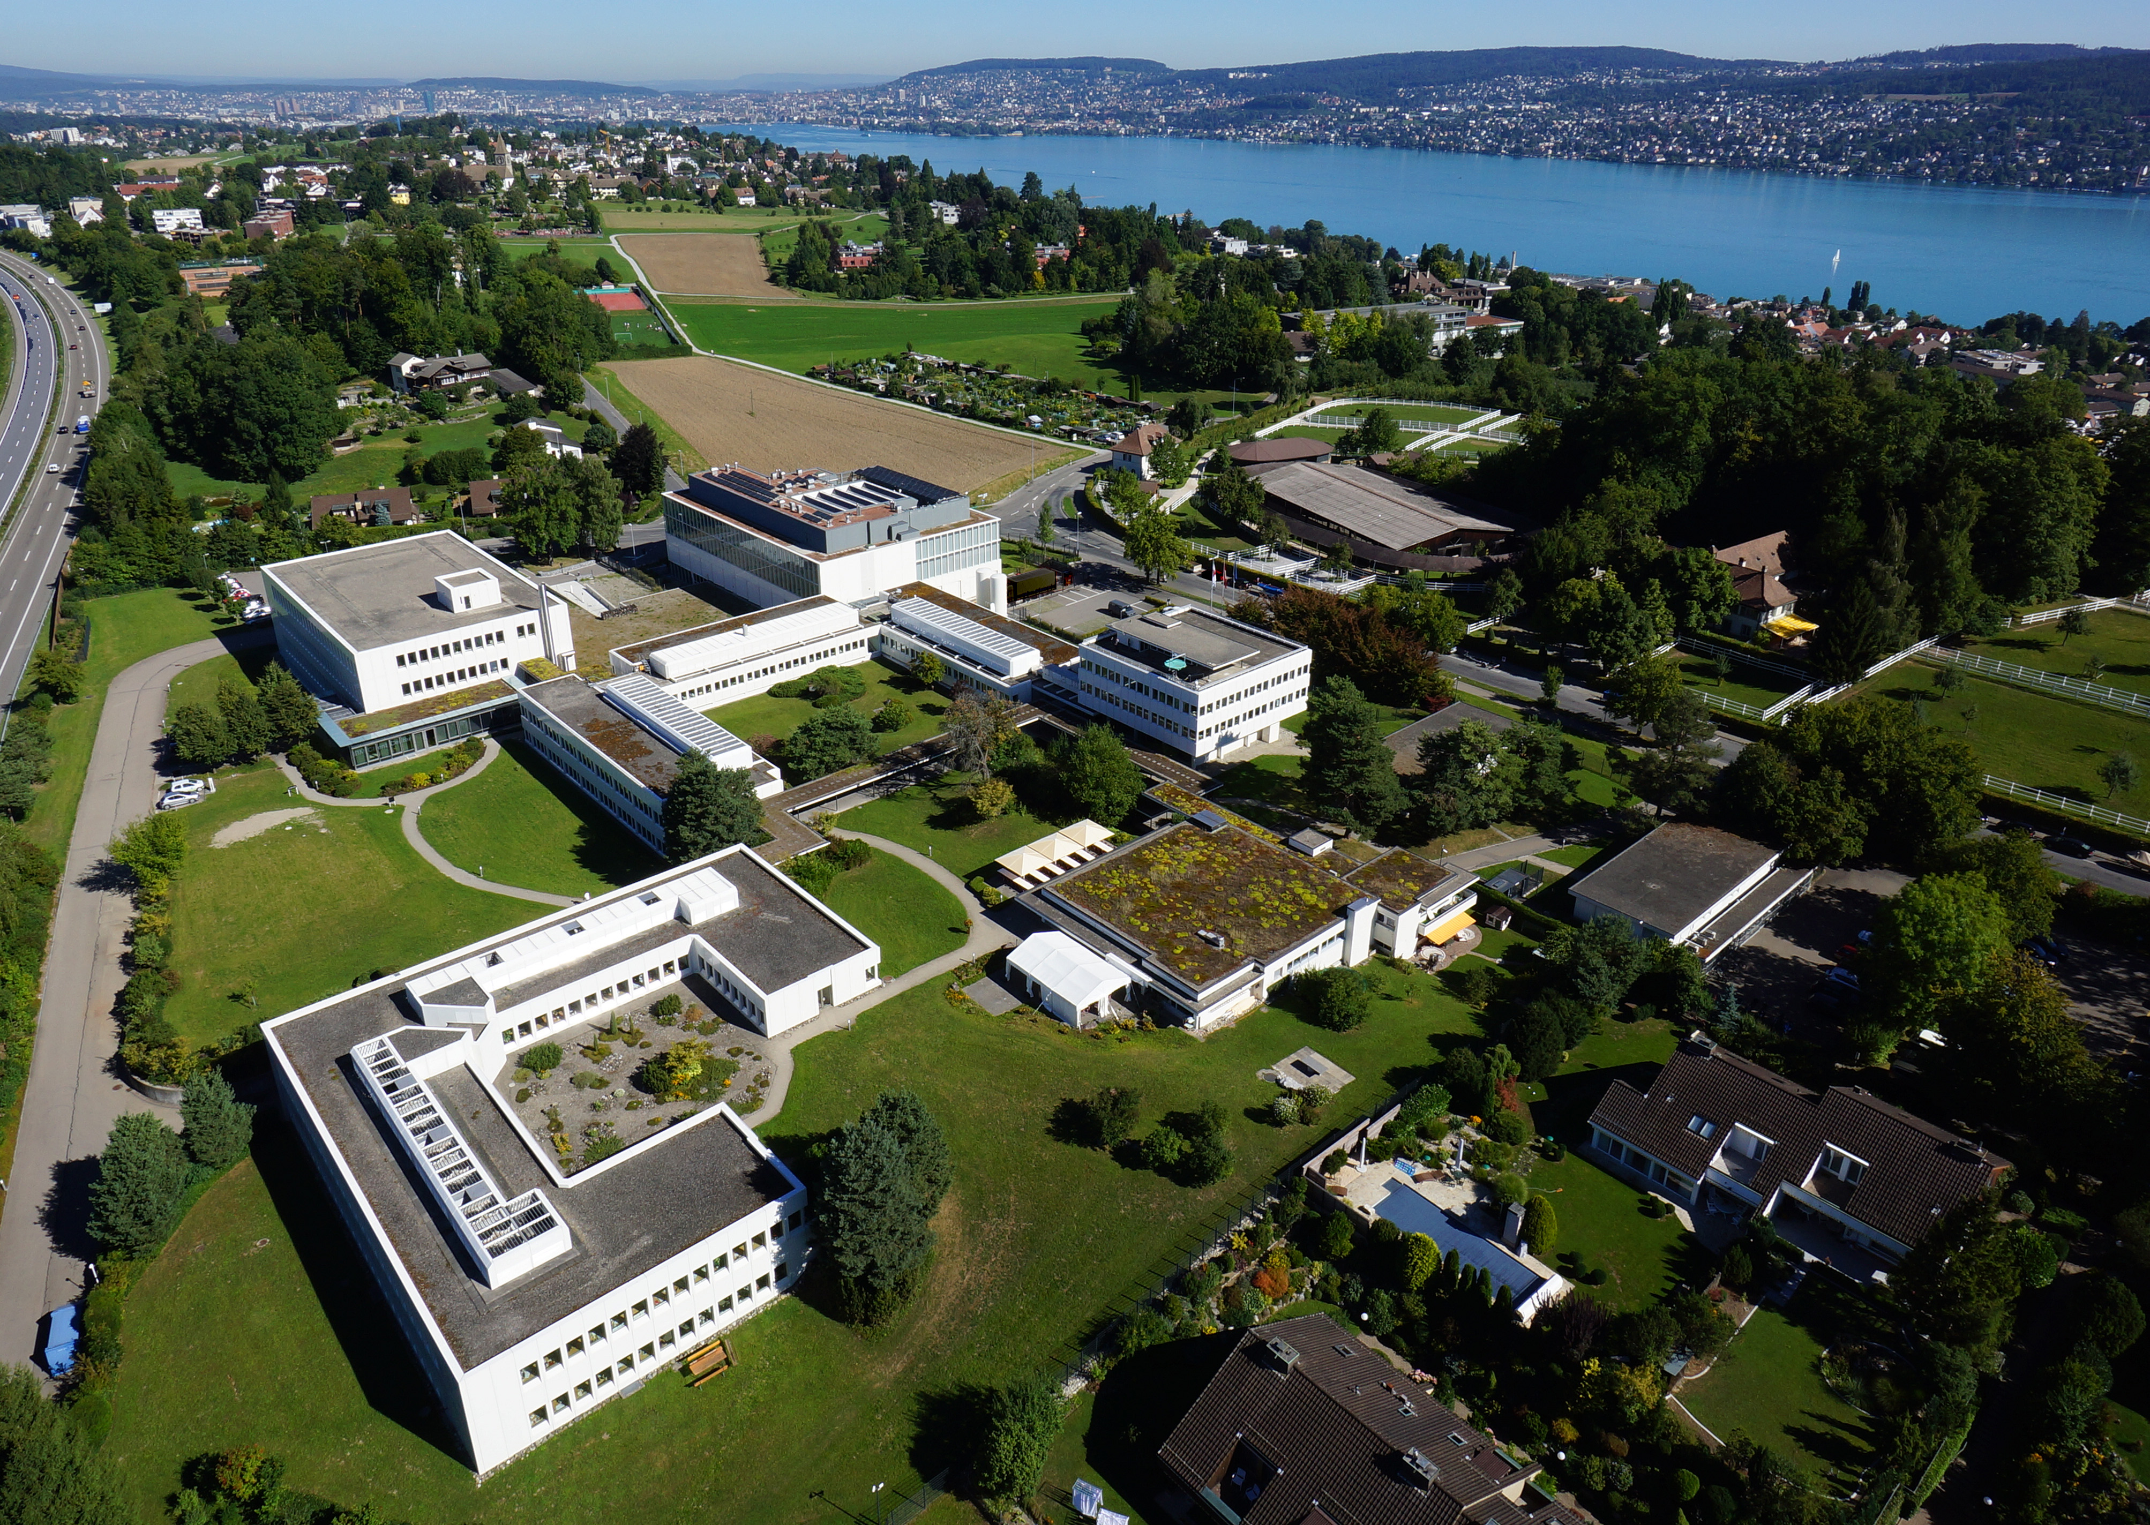
IBM Research / IBM Corporation © 2024
2

Slide 3
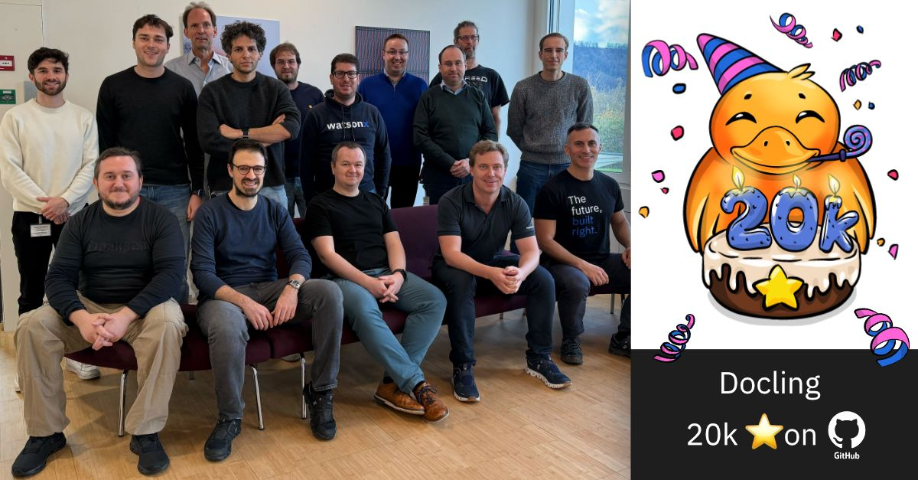
Docling

Slide 4
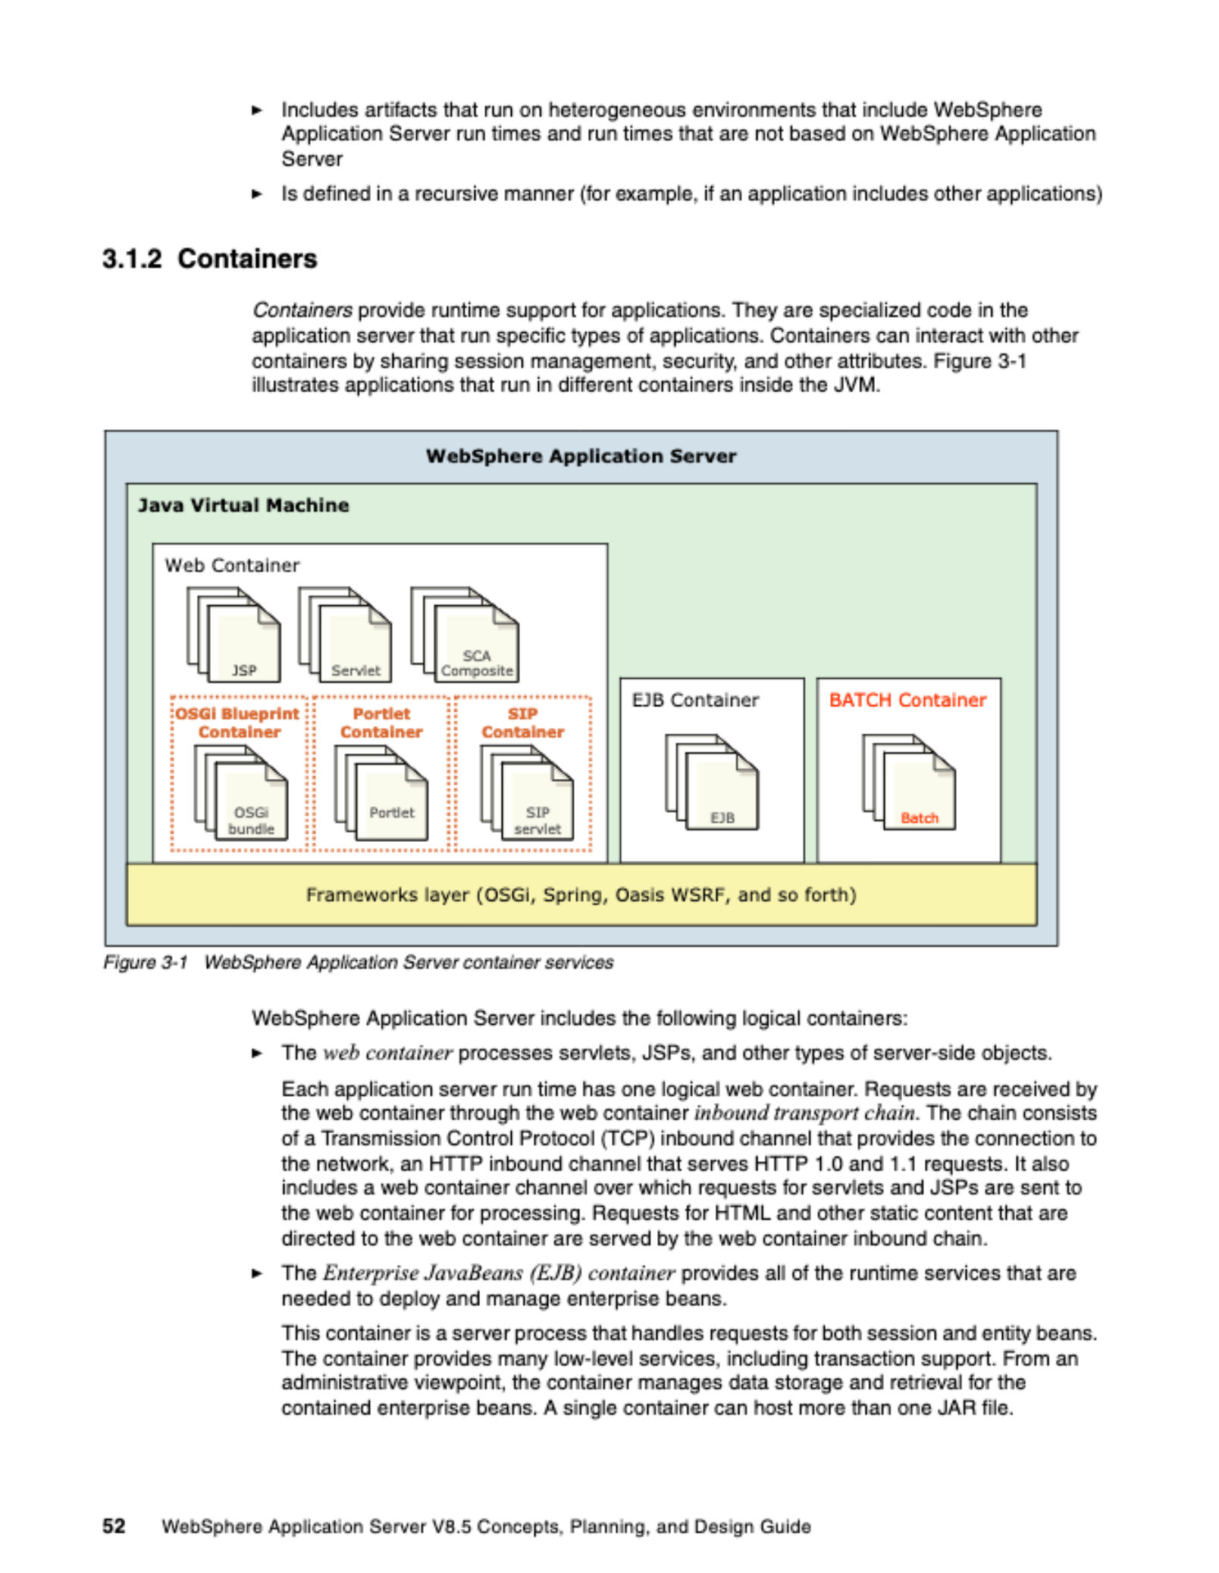
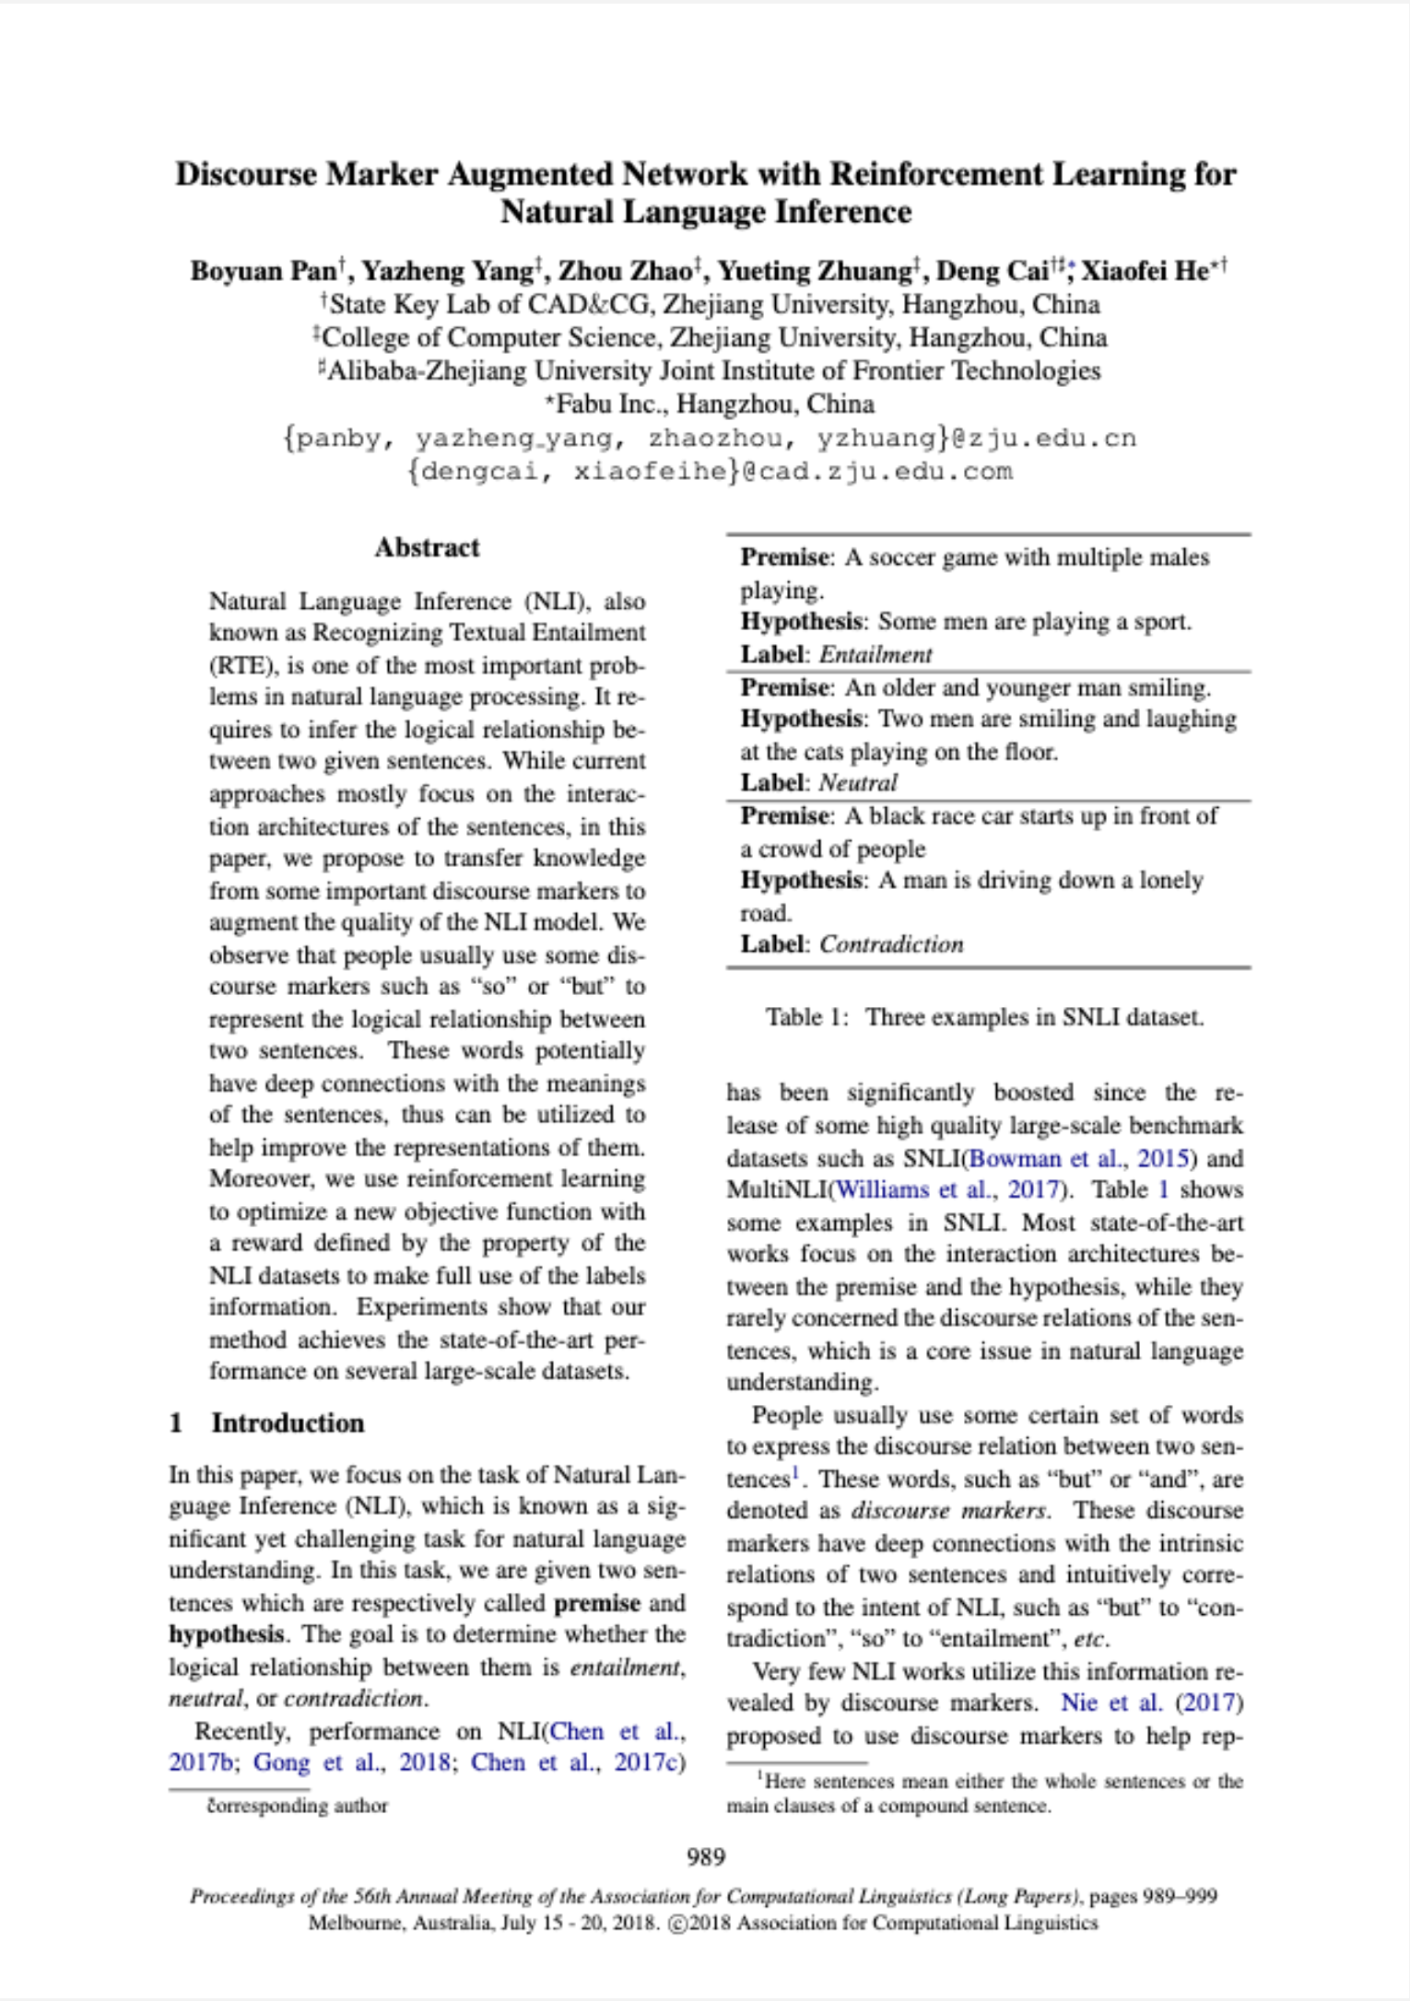
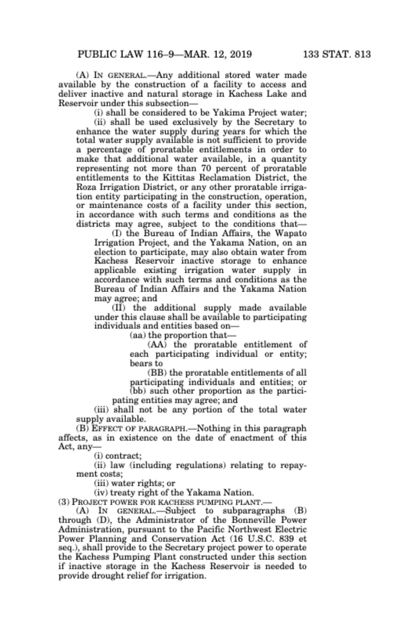
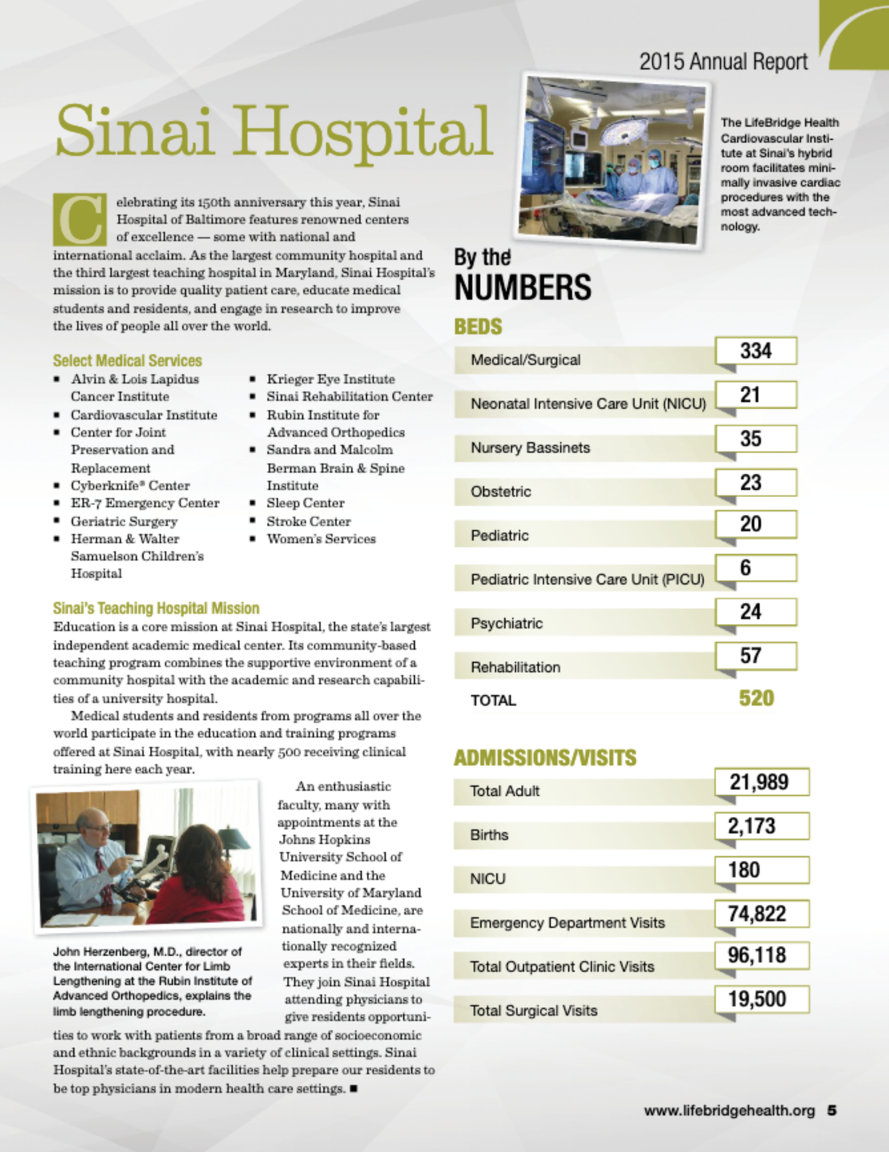
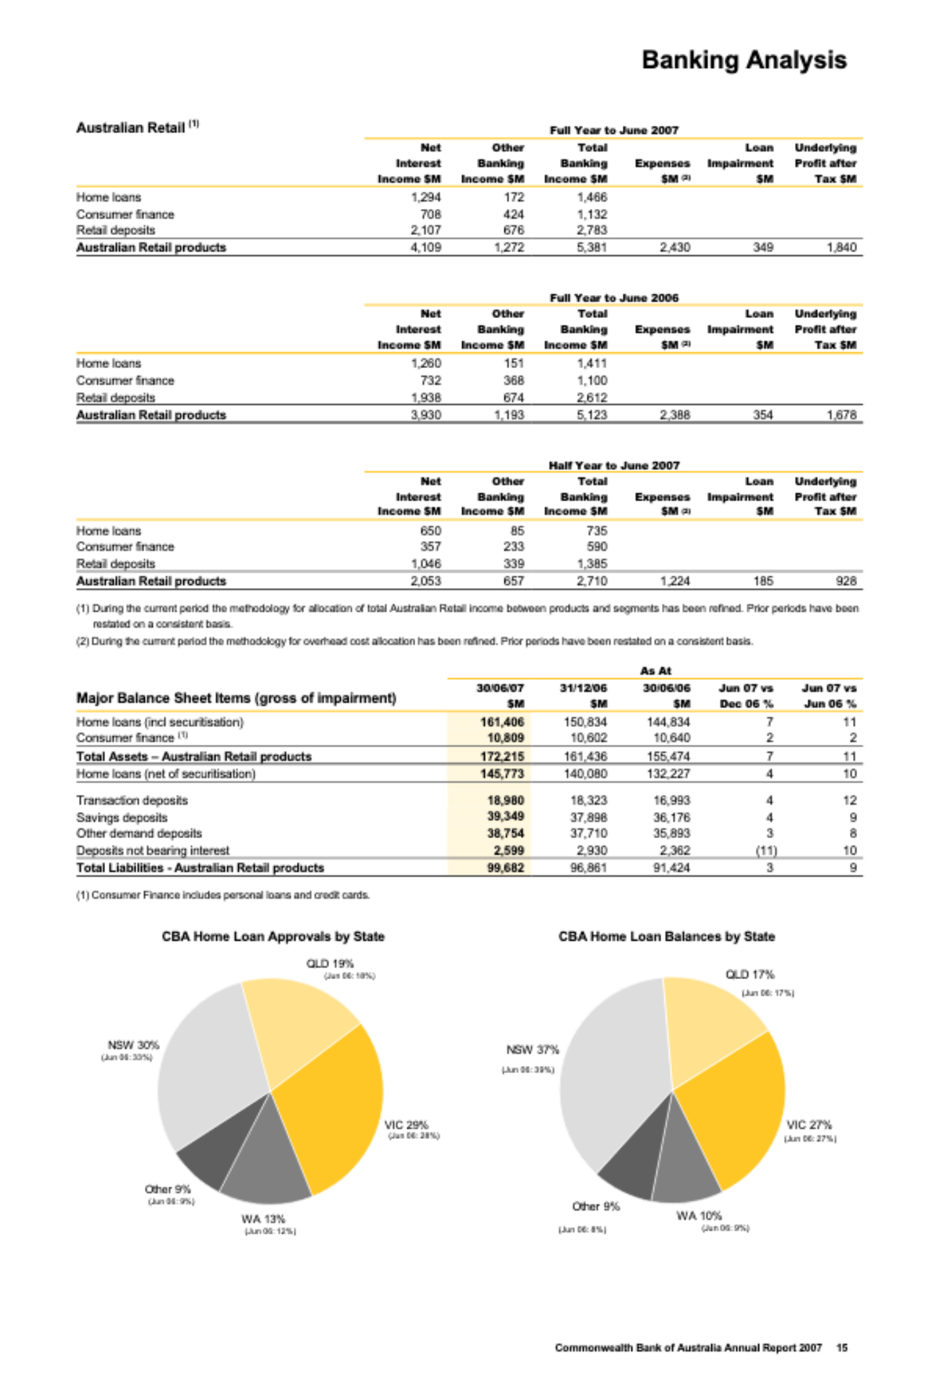
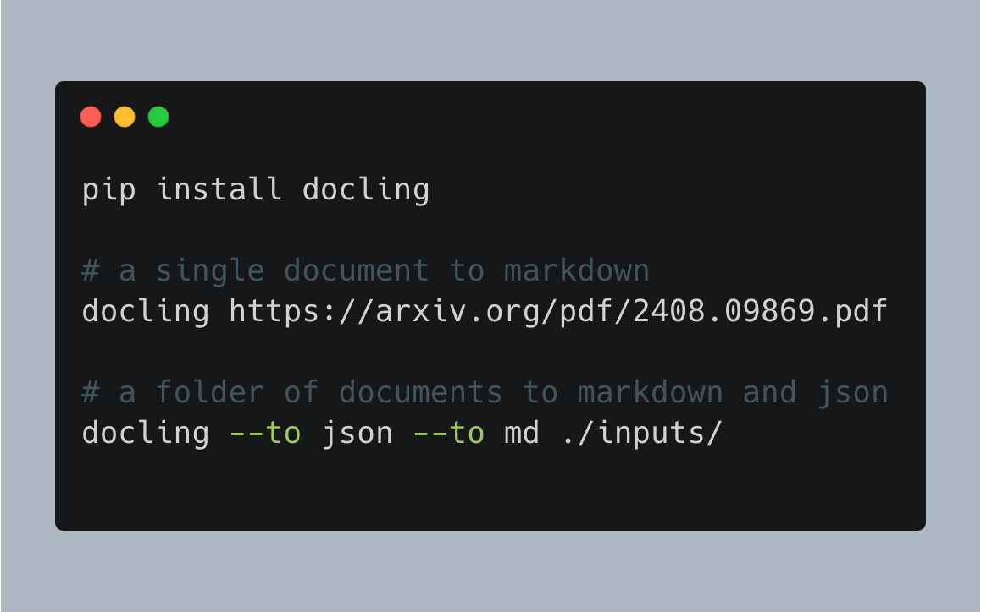

Introducing Docling
🗂️ Parsing of multiple document formats incl. PDF, DOCX, XLSX, HTML, images, and more
📑 Advanced PDF understanding incl. page layout, reading order, table structure, code, formulas, image classification, …
🧬 Unified, expressive DoclingDocument representation format
↪️ Various export formats (Markdown, HTML, JSON)
🔒 Local execution for sensitive data and air-gapped environments
🤖 Many plug-and-play ecosystem integrations
🔍 Extensive OCR support for scanned PDFs and images
🥚 Support of Visual Language Models
💻 Simple and convenient CLI

Slide 5

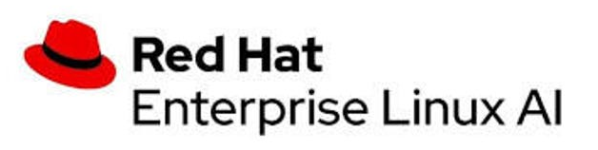


The story behind Docling
InstructLab integration
Red Hat team uses DS API in the ilab UI
First integrations
Docling is used in data-prep-kit, LlamaIndex, LangChain
New document formats
Docling v2 has native support for docx, pptx, html, and more
InstructLab 0.21
Docling is used for knowledge taxonomy in InstructLab
Early 2024
July 18th
Early Nov
Dec 4th
June
August
Early Oct
Nov 16th
Let’s go open-source!
Executive decision to support InstructLab with an open-source version of the DS conversion
Docling goes viral!
+10k GH ⭐ in a week
No. 1 repository in Github.com trending
Most popular IBM open-source
RHEL AI 1.3
Docling is included in the RHEL AI 1.3 release
Deep Search and InstructLab
Deep Search leveraged by InstructLab team for ingesting books
Docling is released

Slide 6


Docling in 1Q25
Going viral!
SmolDocling:
Single VLM Model for OCR/Layout/table/chart
EquationFormer:
Model for equation understanding
CodeFormer:
Model for code understanding
Reading-Order:
Model for reading-order
Docling-MCP:
Agents operations with Docling
Workshop at AAAI 2025
Jan 2025
Feb 7
Feb 10
Feb 11
Feb 14
Feb 21
Mar 10
Mar 18
Jan 25
Feb 9
Feb 18
Mar 8
Mar 17
Mar 19
Docling-dpbench: complete dataset for quality
Right-to-left language support
Caption/footnote linking
Docling-serve: Rest-API for deploying Docling at scale on RHOAI
Docling joins LF AI & Data
Moving Docling to a completely open-source governance
Granite-vision integration
Updated TableFormer
Support for char, word and line PDF extraction

Slide 7
Docling: Roadmap
Open points
Schema-based extraction via SmolDocling
Expanding Markush understanding
Document generation and manipulation
Expand MCP agentic tools
Charts understanding
Conversion confidence
Document classification
OpenShift Operator
Run batch jobs at scale
Charts Understanding
Llama Stack
Document processing API
Docling Granite-Micro
April 2025
May 2025
October 2025
IBM THINK
Full Llama Stack
Including Deep Search experience rebased
Chem Pipeline
Run PatCID pipeline natively with Docling
Key-Value
Understanding
Red Hat Summit
IE processing pipeline
IBM TechXchange

Slide 8
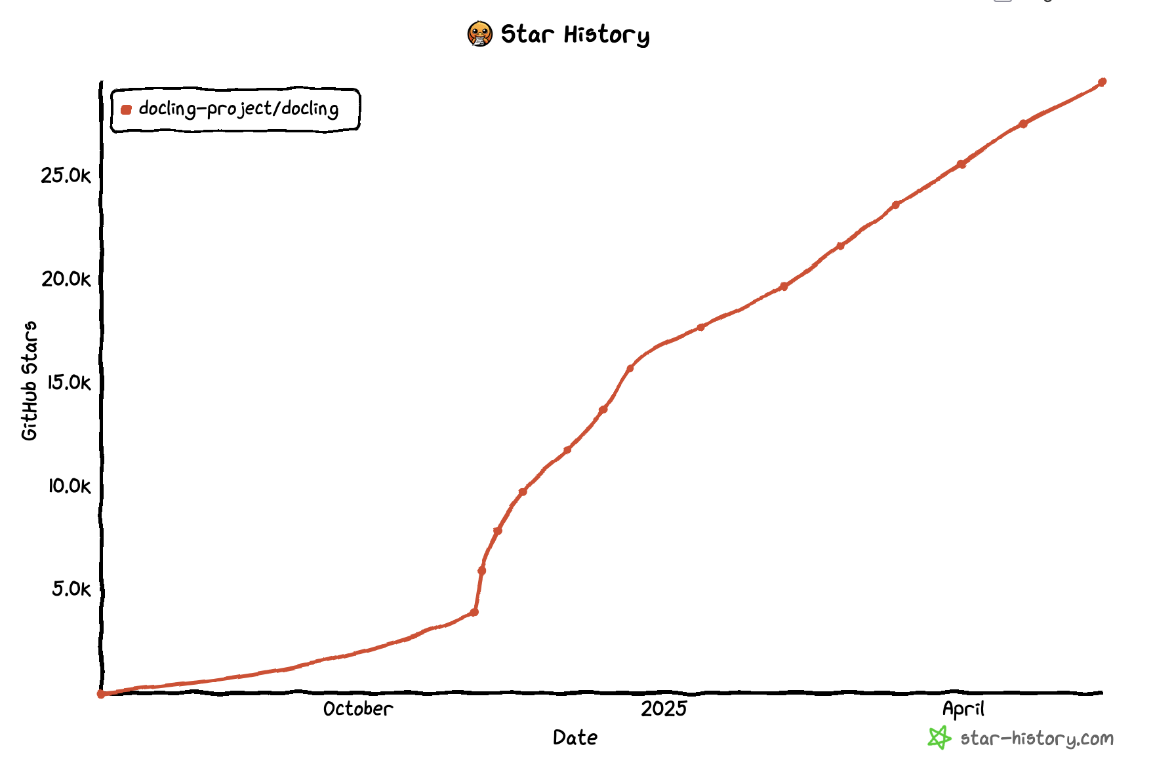
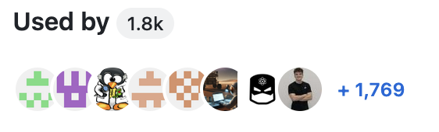
Community Adoption
A rising star in the open-source space
⭐ 30k+ GitHub stars
10M+ Social impressions
🐍 500k+ downloads/month from PyPi
Countless YouTube videos
Countless Articles (Blogs, Medium…)
Notes:
And we have been delivering on it.
Amazing response from the community, we find ourselves on the center stage of document understanding space
In November, Docling went viral and became #1 trending package on Github, 12k stars in just about 1 month
Since then we are flooded with feedback, code submissions for new features, and collaboration projects

Slide 9
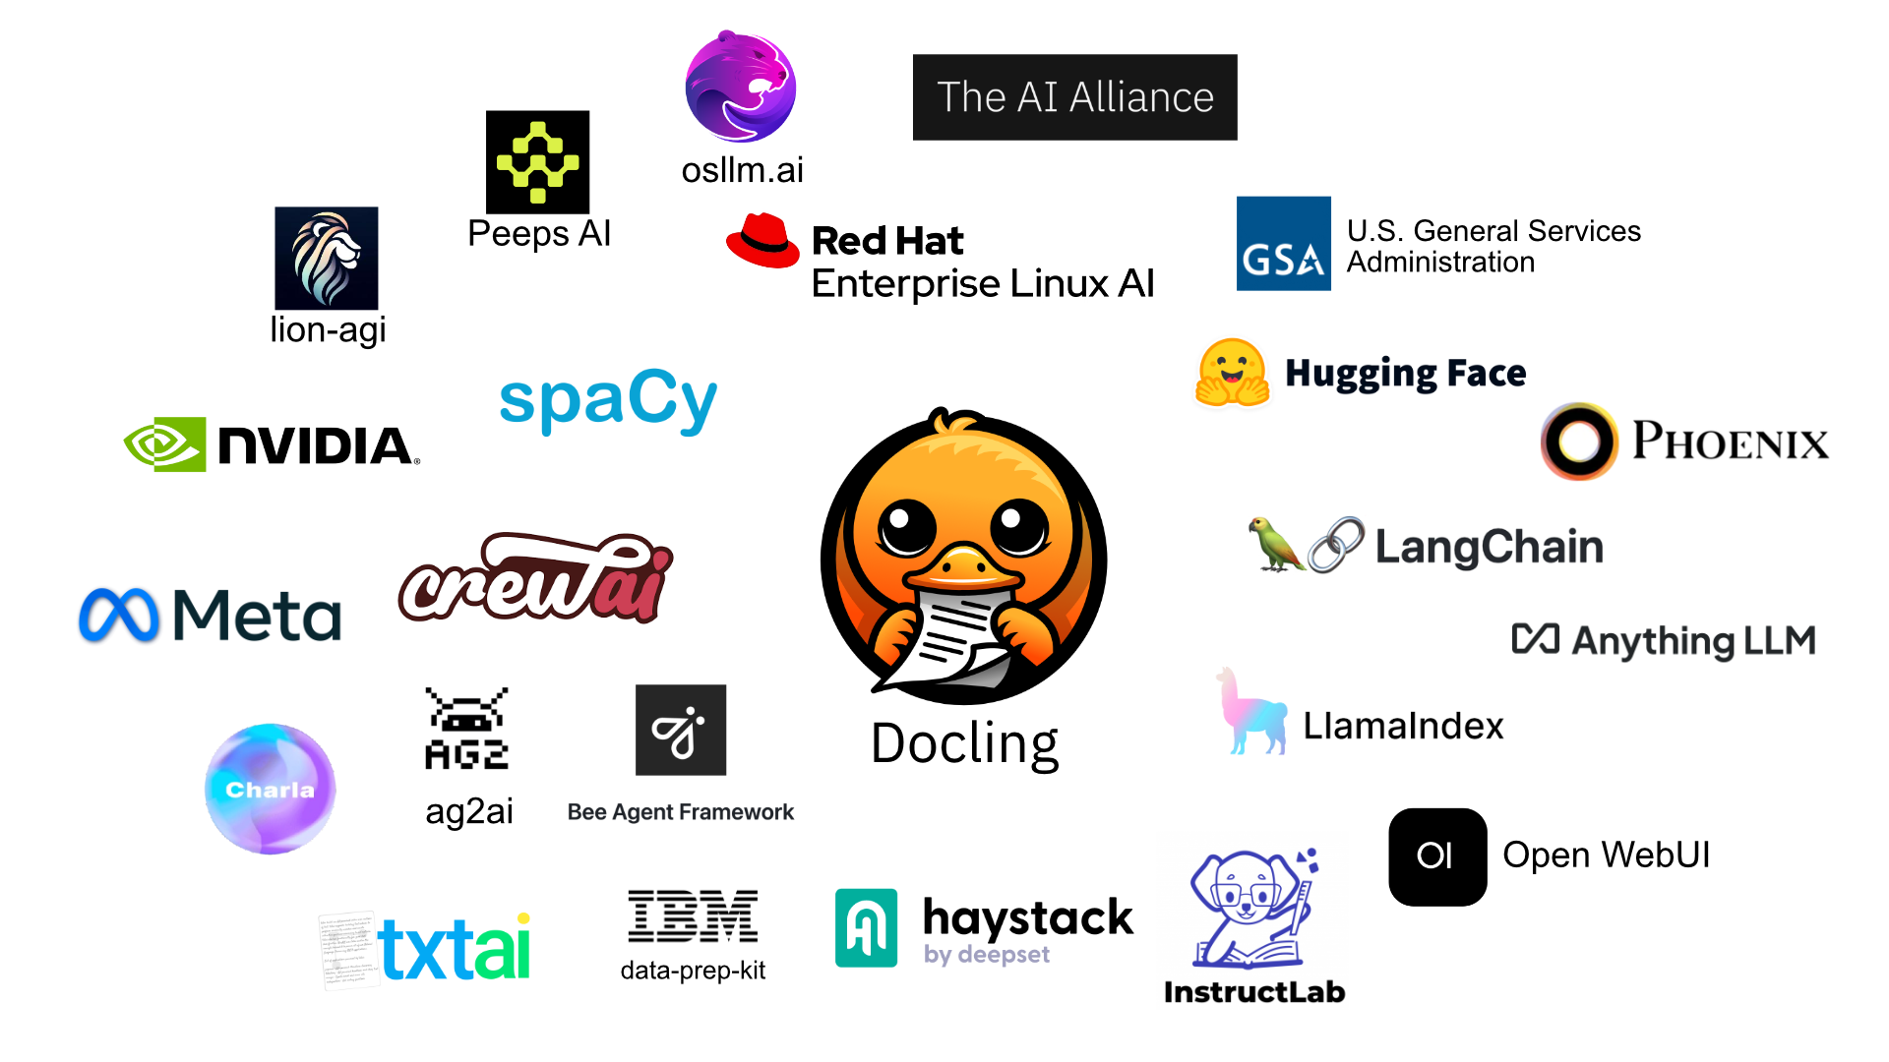
Ecosystem
RAG Frameworks
Agentic systems
Dataset generation
Vector databases
Client solutions
Notes:
Making it developer friendly also means seamless integration into popular data science and AI frameworks
We provide native integration within LlamaIndex, LangChain and soon Haystack
The public community has picked up on Docling and we see new integrations developing every week
We are working full steam to guide people with their integrations
Agentic workloads can leverage the integration with the Bee framework
For the fine-tuning of language models, Docling is integrated in InstructLab.I t supports the enhancement of the knowledge taxonomy.
Data-Prep-Kit leverages docling to transform documents at scale for multi-modal training datasets, through ray
RedHat ships it as officially maintained package in RHEL AI 1.3

Slide 10
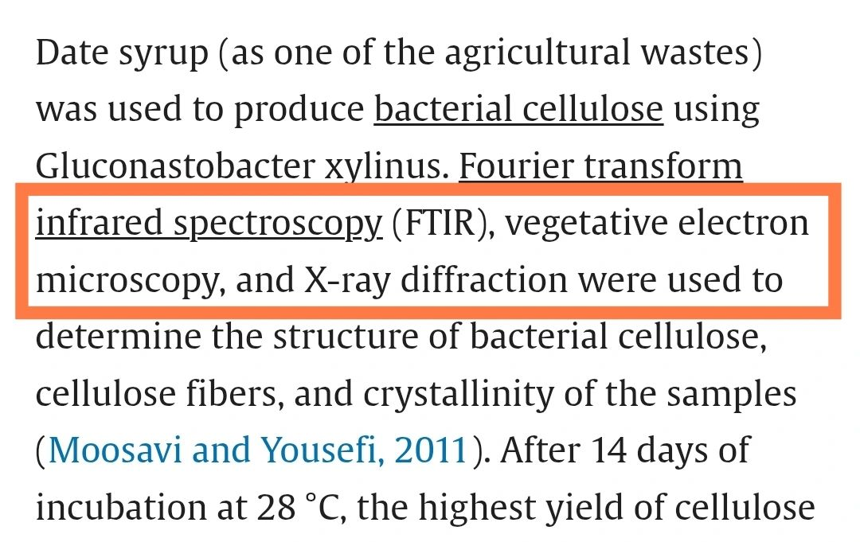
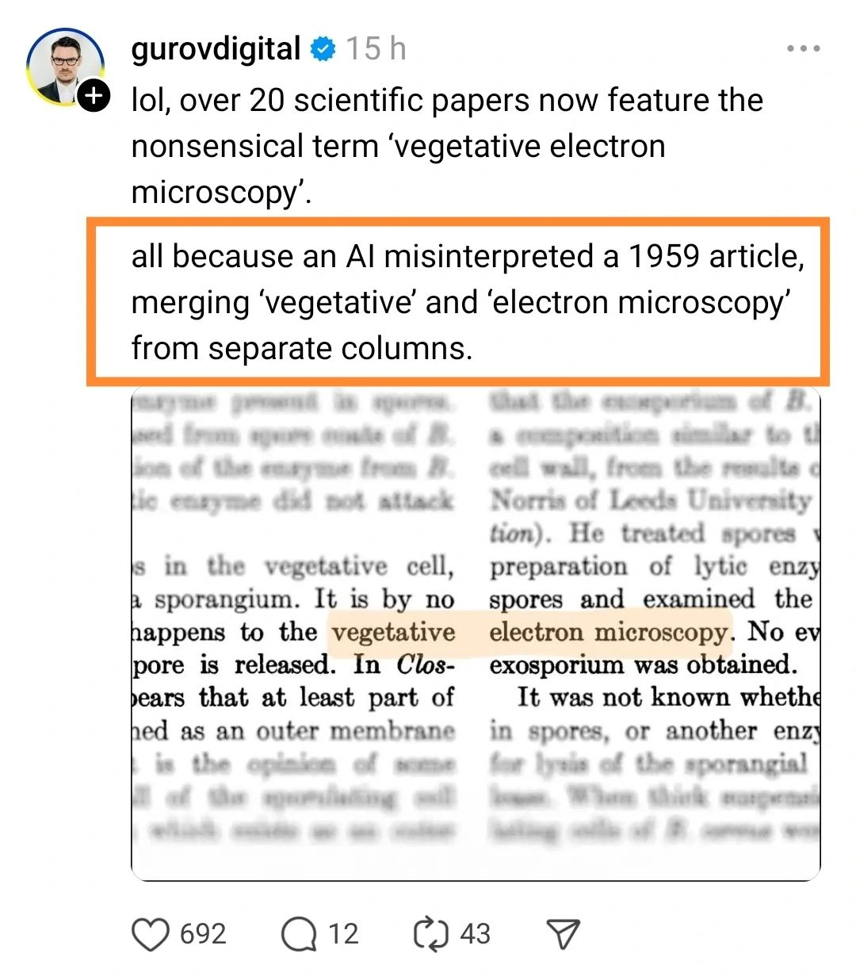
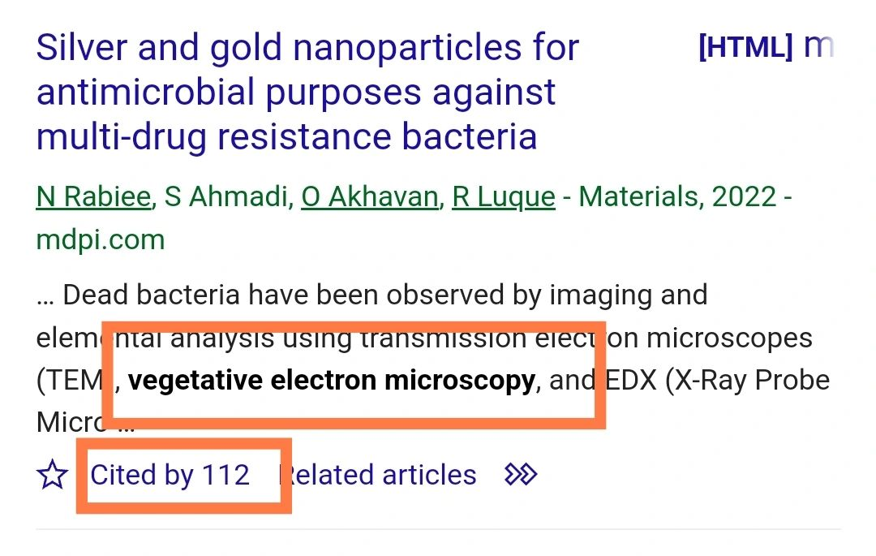
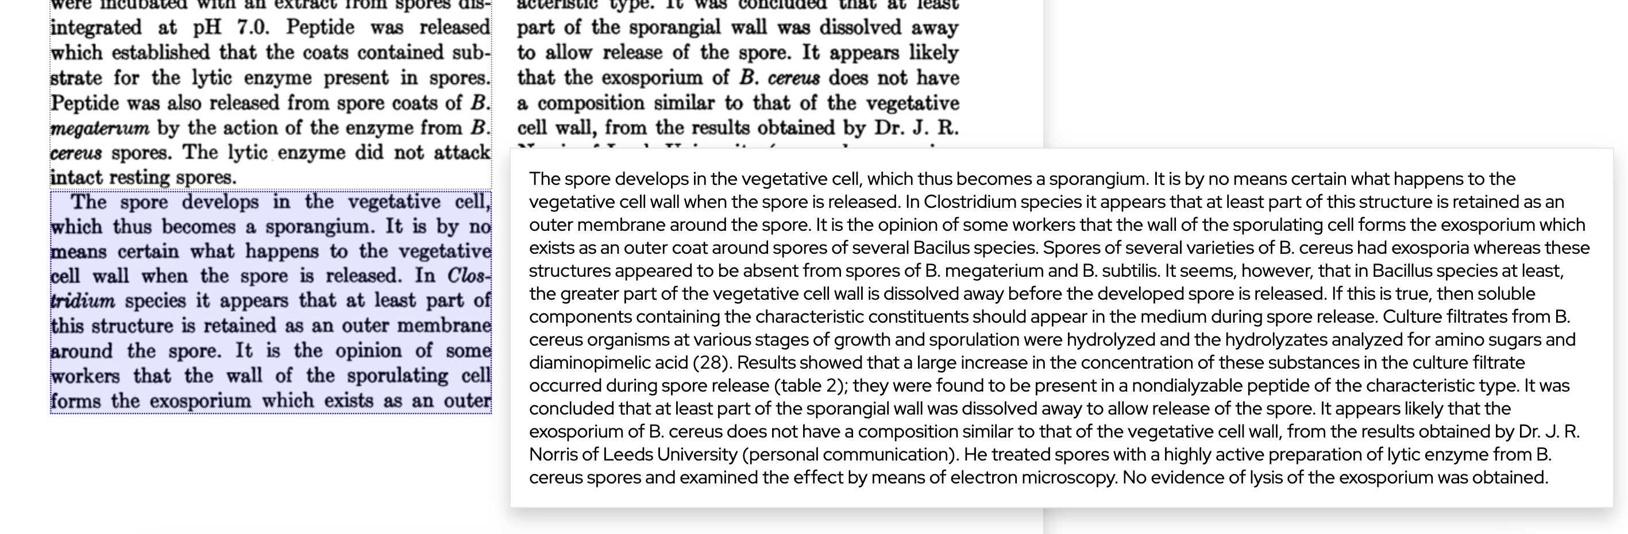
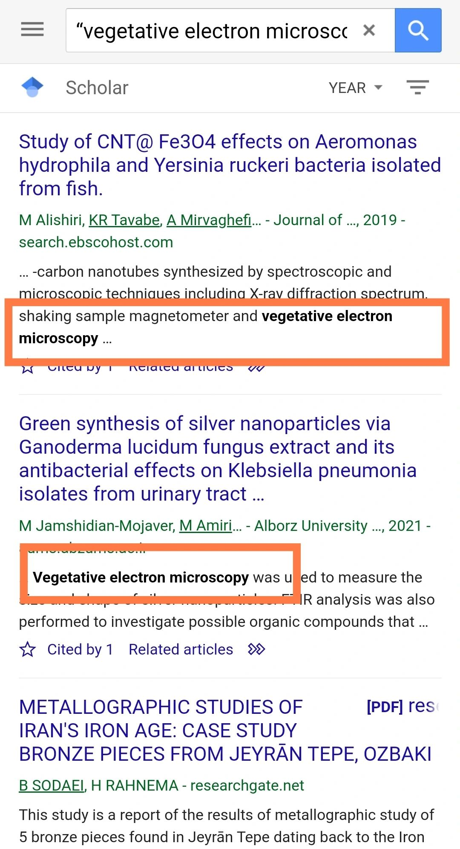
Without Docling…
…it can go bad.

Slide 11
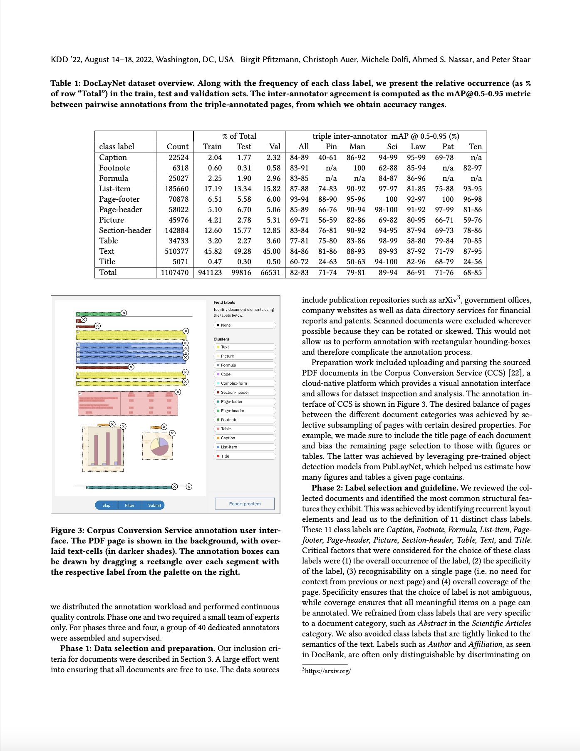



Recovering structured content from PDF
with low-level PDF parsers
!
undesired
page headers
KDD ’22, August 14–18, 2022, Washington, DC, USA Birgit Pfitzmann, Christoph Auer, Michele Dolfi, Ahmed S. Nassar, and Peter Staar
Table 1: DocLayNet dataset overview. Along with the frequency of each class label, we present the relative occurrence (as %
of row “Total”) in the train, test and validation sets. The inter-annotator agreement is computed as the mAP@0.5-0.95 metric
between pairwise annotations from the triple-annotated pages, from which we obtain accuracy ranges.
% of Total
triple inter-annotator mAP @ 0.5-0.95 (%)
[…]
Count
22524
6318
25027
185660
70878
58022
45976
142884
34733
510377
5071
1107470
[…]
include publication repositories such as arXiv3, government o"ces,
company websites as well as data directory services for #nancial
reports and patents. Scanned documents were excluded wherever
possible because they can be rotated or skewed. This would not
allow us to perform annotation with rectangular bounding-boxes
and therefore complicate the annotation process.
[…]
Very fast and cheap
Incomplete
Loss of structure
Noisy
Unfit for most use cases
!
Tables not understood
!
Image content missing
!
Line wraps not understood
!
Multi-column often breaks order
Notes:
Where does that put docling in the space of available solutions?
At one end of the spectrum, we have basic PDF parsing libraries
Pdfium
PDFMiner
pypdfium

Slide 12
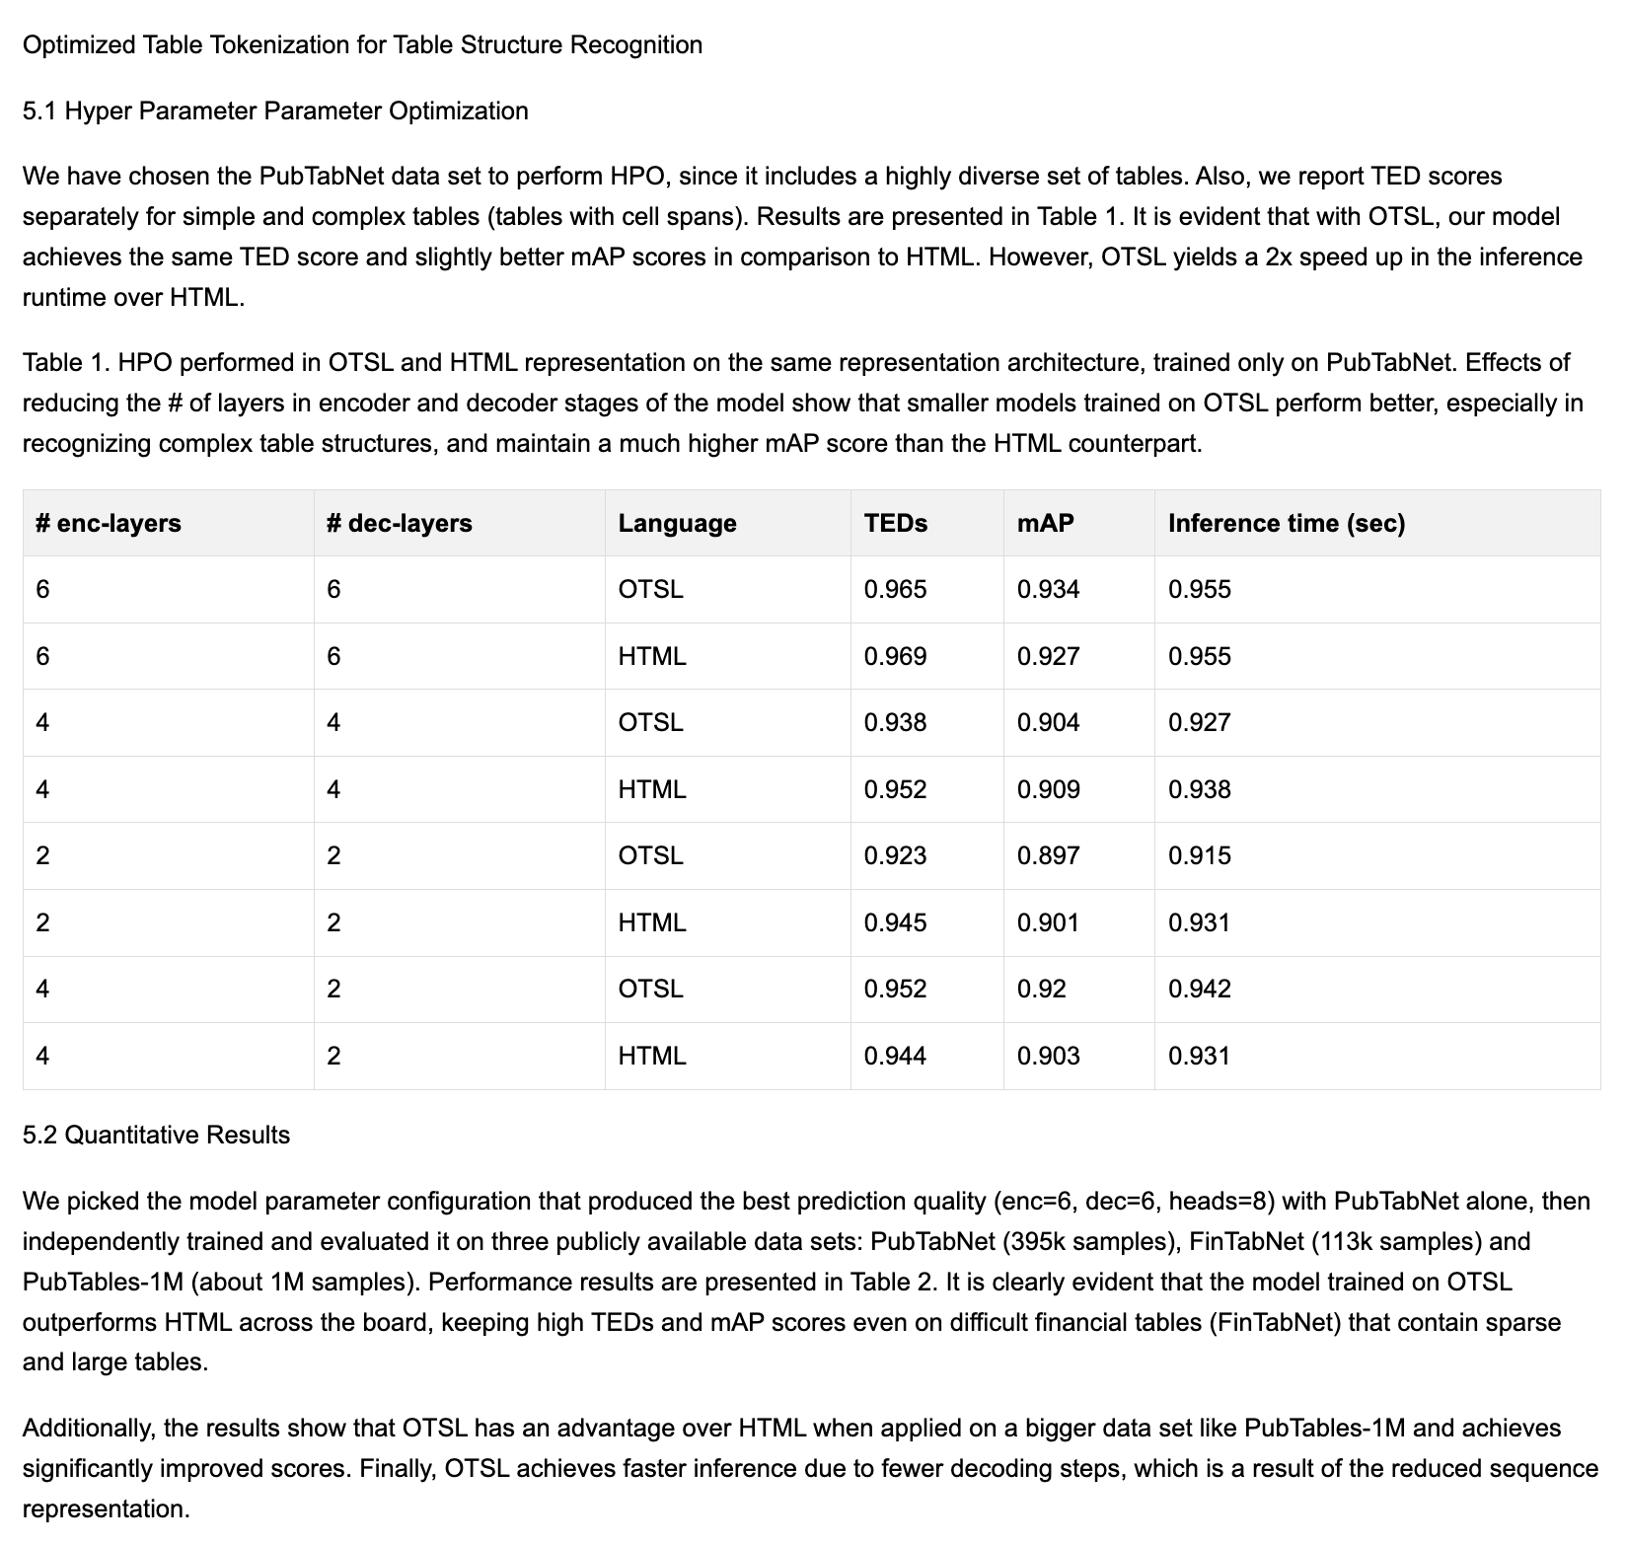
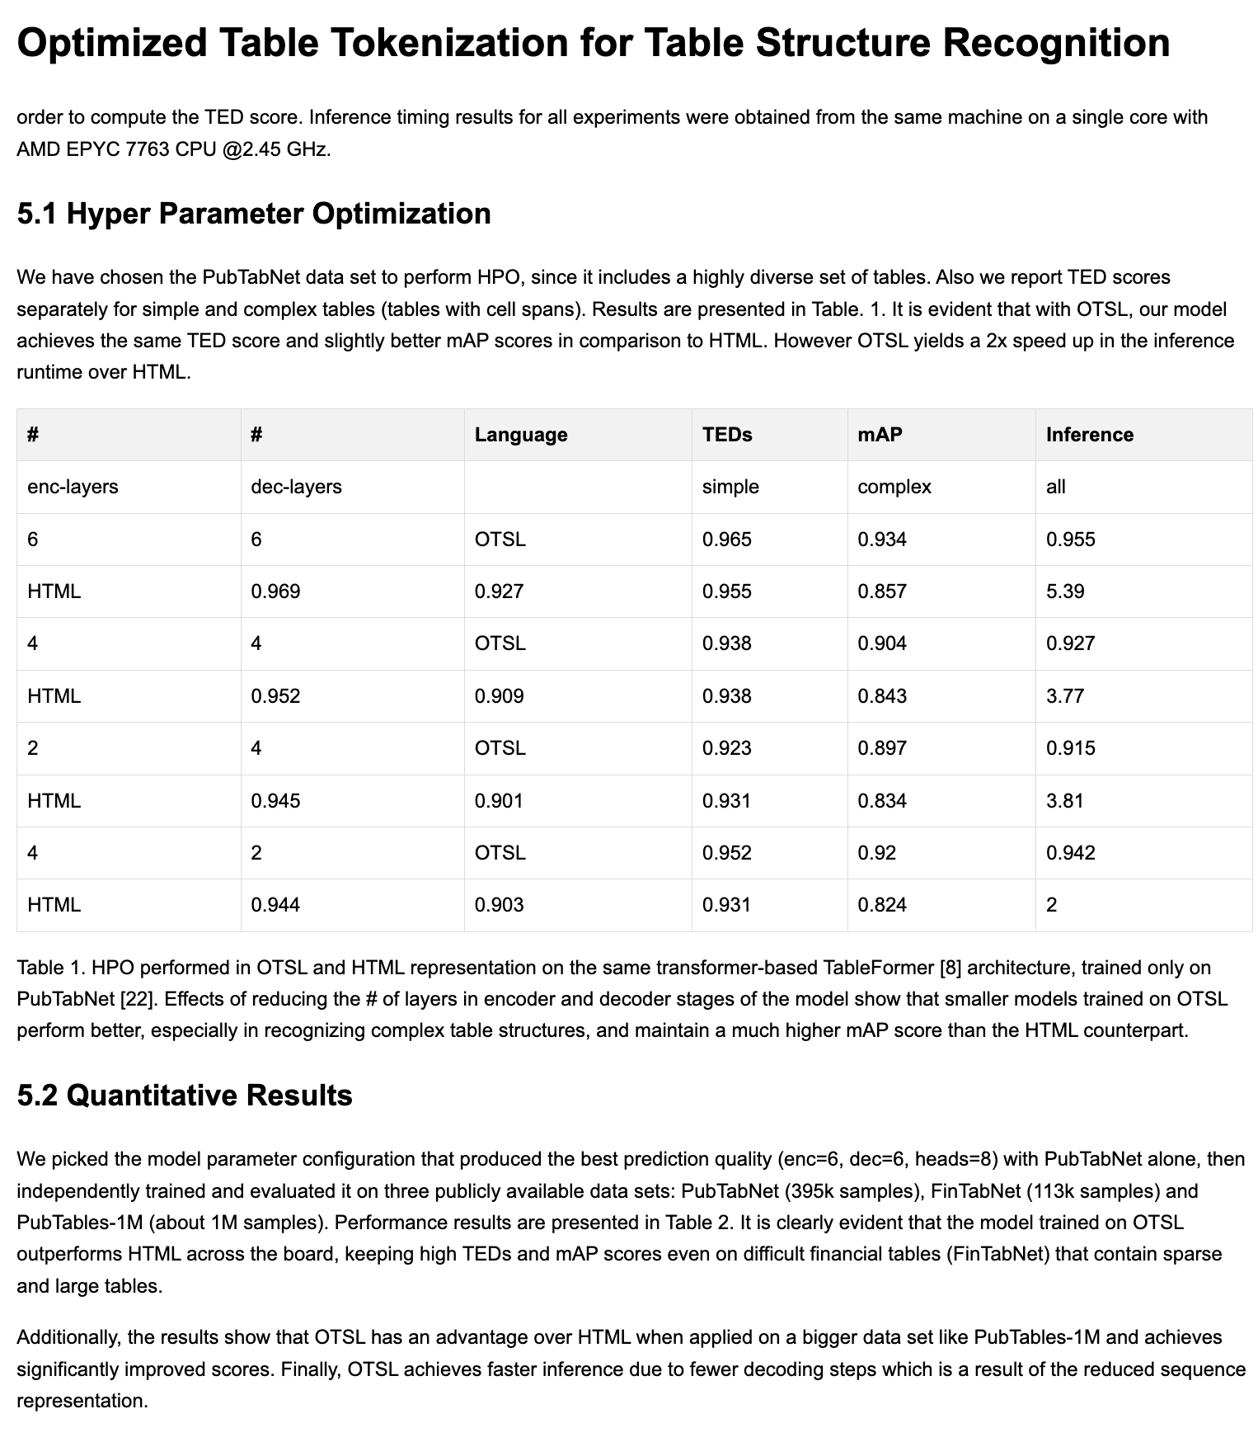
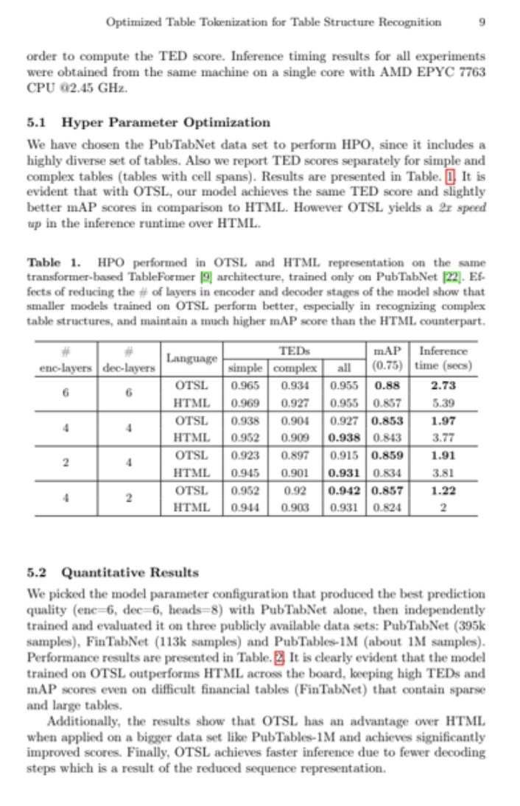
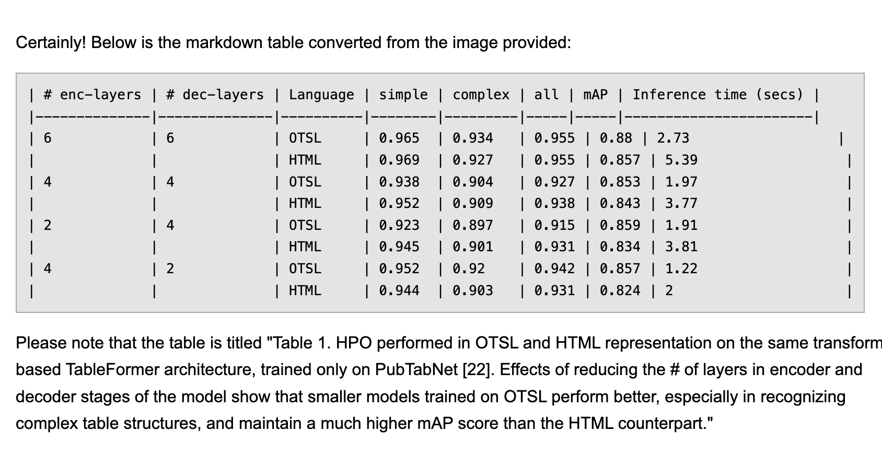
Qwen2.5-3B (25 sec)
Pixtral 12B (287 sec)
Source
Phi4-14B (350 sec)

Slide 13
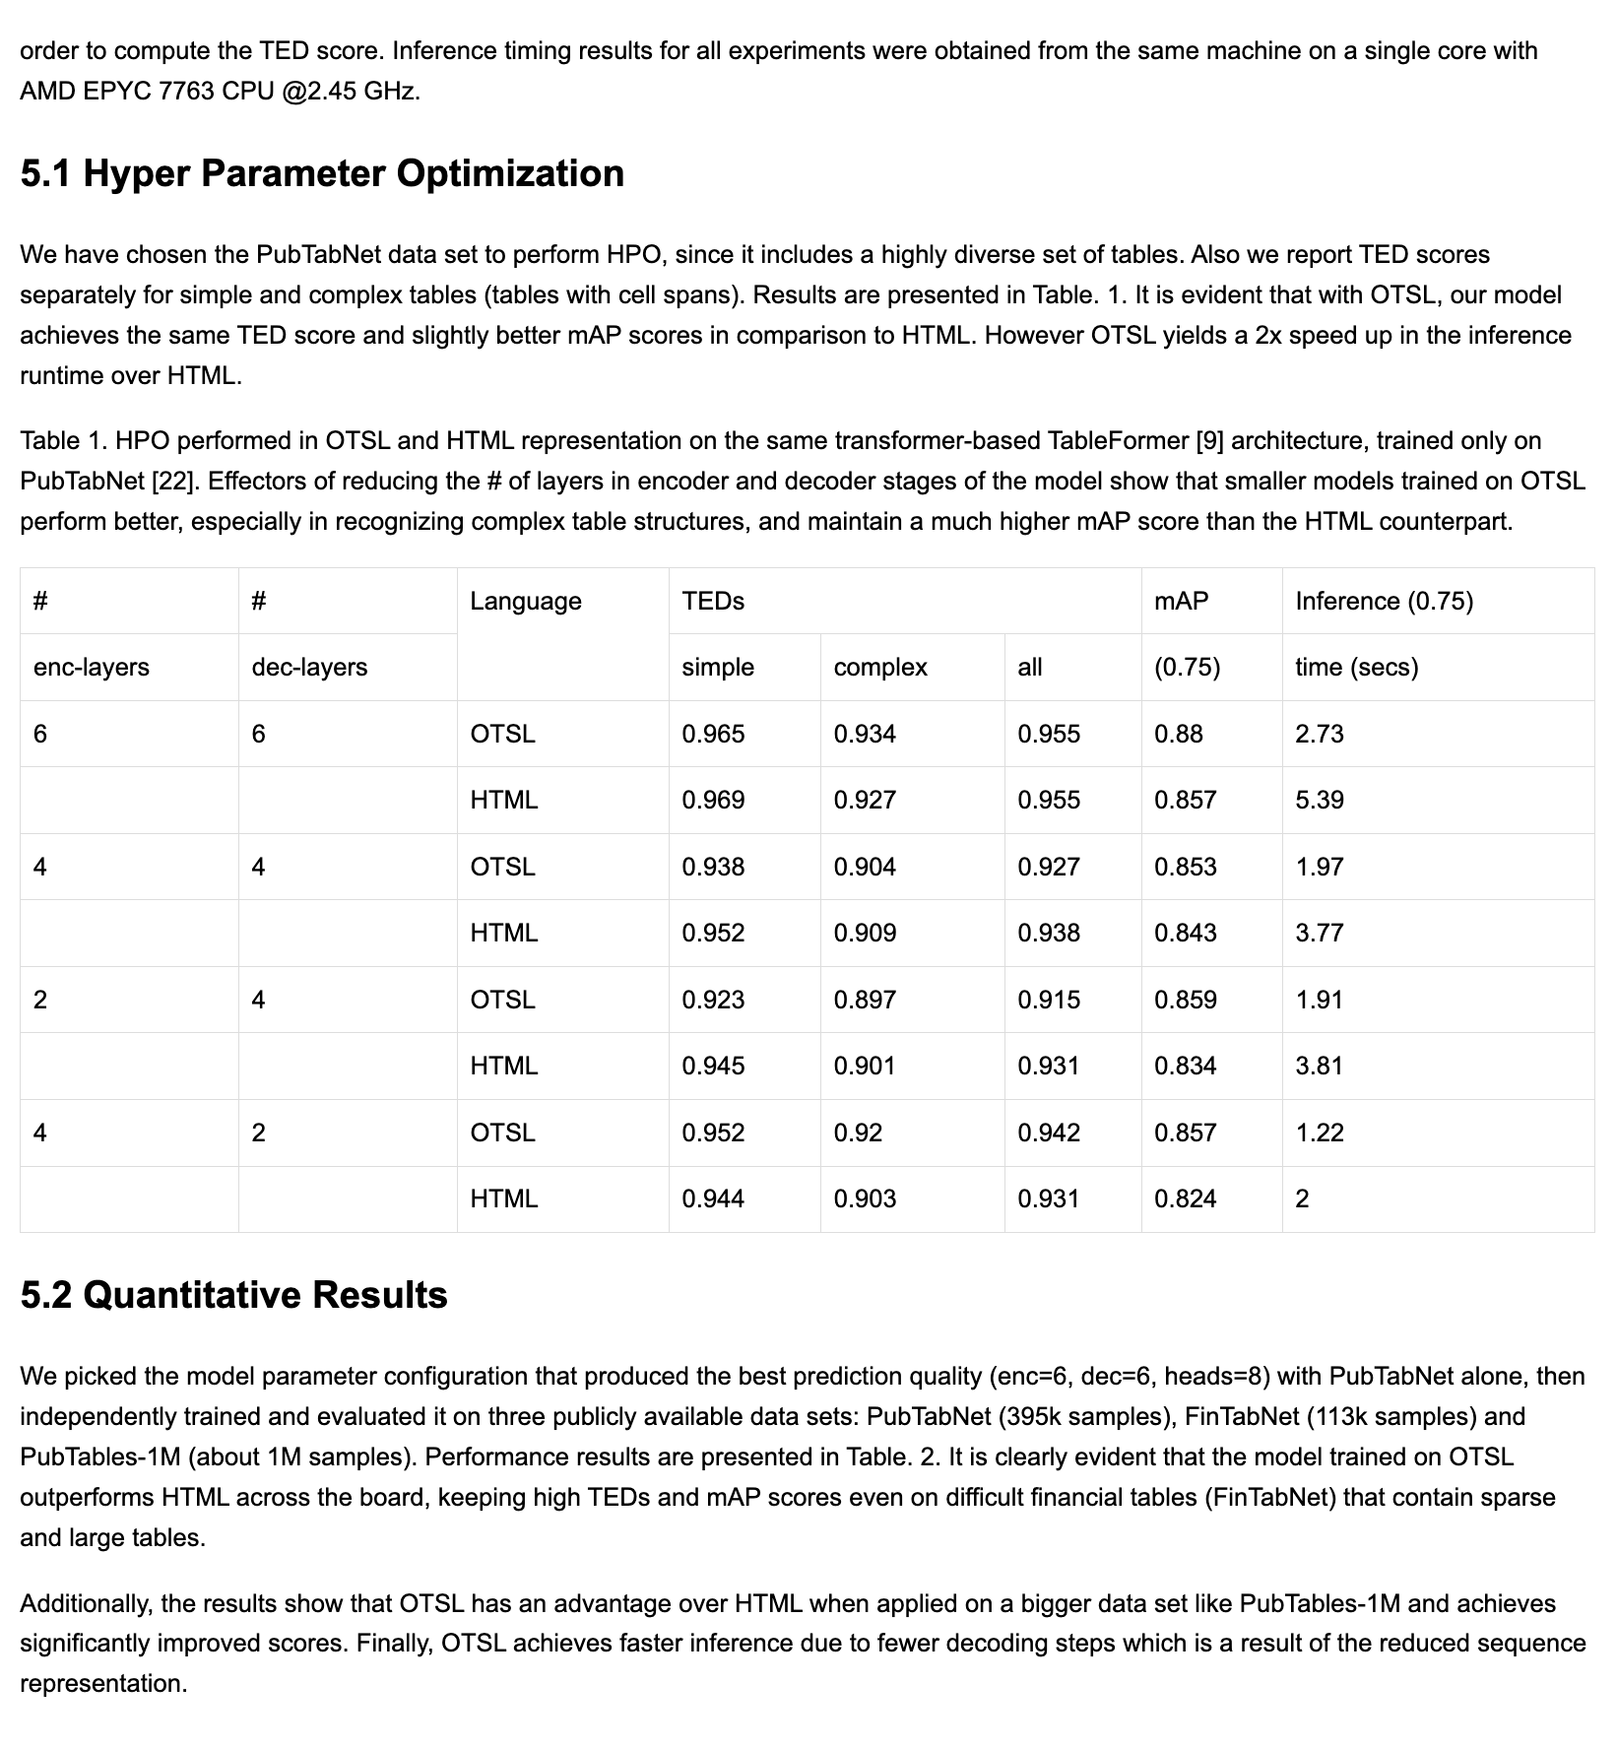
Source
SmolDocling (4 sec)

Slide 14
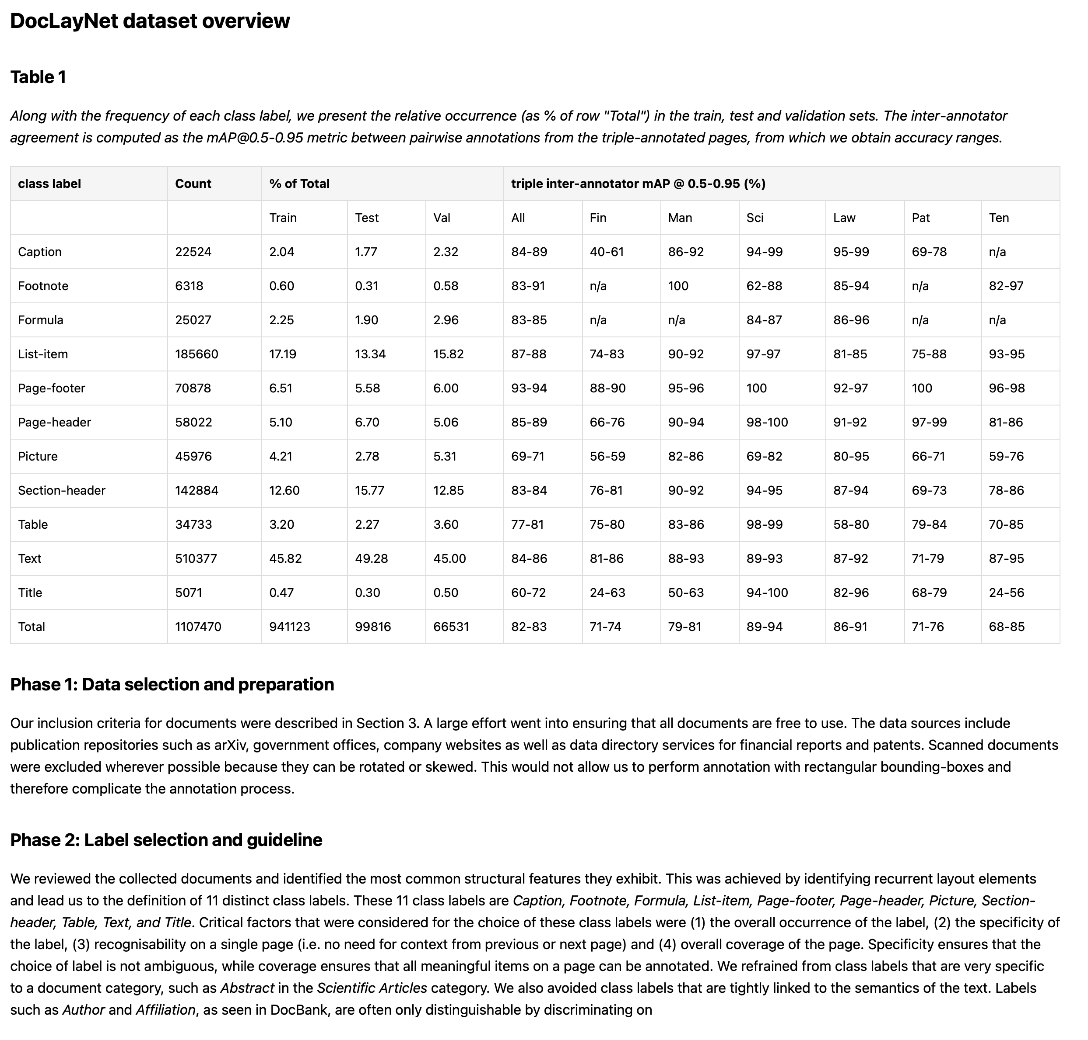
Recovering structured content from PDF
with strong vision-language models
Good quality and robustness
Expensive (for now)
Hard to achieve consistent structured output
Possible hallucinations
Very costly at scale and not always faithful to source
⚠️
⚠️
Notes:
On the other end, we have very powerful frontier models
GPT 4o
Claude
Tools like:
Llamaparse
- Good results, but oversized for the task

Slide 15
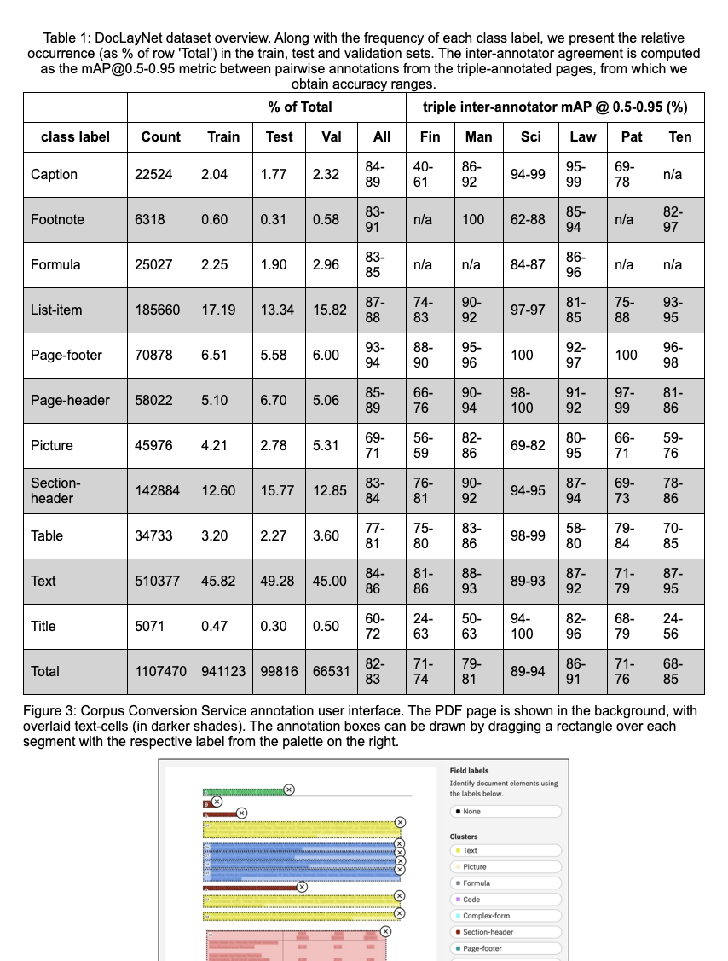
Recovering structured content from PDF
with Docling
Good quality
Fast and cheap
Fully local operation
Structured format output
Cost-effective at scale, with consistent representation and high quality
*results rendered as HTML for visualization purposes
Notes:
Docling is adopting the best traits from both ends

Slide 16


A full-stack approach for the open hybrid cloud to scale Document processing across the enterprise
watsonx.ai
Build advanced applications
Docling on RedHat
Scale Docling to Enteprise
watsonx Discovery
Search millions of preloaded documents: Patents, Open-Access Publications, Public Repositories and News articles
Search made for enterprise in multimodal
watsonx Orchestrate
Orchestrate AI Agents to discover knowledge in documents and mix them with other datasources to create knowledge graphs and datasets.
Schema based structured data extraction from unstructured documents.
Docling
Forever opensource
Deploy and scale conversion anywhere
Delivers consistency, cloud-to-edge production deployment, and monitoring capabilities for document conversion
Fully managed, and self-managed via OpenShift Enterprise Linux footprint
Resource optimization and management
Optimize resources across users for use in model tuning and inference (Instructlab)
Ready to handle 100+ page conversions per minute
Open Document Conversion
Open source python package for PDF document conservion
Understand Layout, Reading order, tables and extract meta datas
Includes a simple CLI
LLM/VLM & Agentic
Ready
Easy integration to llamaindex and langchain
Agents integration as a tool to process PDFs in frameworks like crew.ai and LangGraph
Leverage SOTA LLM/VLM
IBM Consulting
Transforms your organization with advanced technologies
Ensure design, integration, deployment and adoption of novel methods and tools for processing documents
Create novel components with IBM Research to make your science unique and disruptive
IBM Research
IBM Consulting
Notes:
RHEL AI will be integrated in OpenShift AI, which is the underlying hybrid platform that watsonx.ai is built on
watsonx.ai users will continue to have access to all of the Granite foundational models, which will be made available on Hugging Face and included in Red Hat's products.
Red Hat will maintain its commitment as a leading provider of open source technology, serving as the foundation of our AI tech stack. Meanwhile, watsonx will differentiate itself by focusing on enterprise capabilities and innovation higher up the AI tech stack.
Note:
RHEL AI is a single-server, non-High-Availability (HA) offering, primarily targeted for individual developers or small teams, and oriented towards GenAI production use cases that do not require high availability. RHEL AI will be embedded inside of Red Hat OpenShift AI (RHOAI).
RH OpenShift AI in turn adds High Availability capabilities, and model lifecycle management (i.e., model serving, training, etc.) across containers, to RHEL AI. OpenShift AI has been embedded within watsonx.ai.
And IBM watsonx.ai adds access to a variety of both open source and proprietary models, an enterprise-ready studio and other tooling for building end-to-end AI solutions, including out-of-the-box integration with other watsonx products, and other enterprise AI capabilities designed to help scale generative AI. IBM watsonx.ai helps make the inferencing engine and scale provided by Red Hat accessible to enterprise applications, workflows, and tools.

Slide 17


watsonx.ai leverages the power of community that Red Hat OpenShift AI and RHEL AI offer
watsonx.ai
watsonx.ai | Multi-model flexibility Access a variety of fit-for-purpose foundation models | Enterprise AI/ML lifecycle Address LOB multi-user and organizational needs for scale and lifecycle governance
Red Hat OpenShift AI | Model serving & monitoring Deploy models anywhere with consistent cloud-to-edge production deployment, and monitoring capabilities | Resource optimization and management Create model pipelines for tuning and alignment, validation and delivery; Share and optimize resources across teams
RHEL AI | Foundation model runtime engine Develop, deploy, and test open Granite language/code models, supported & indemnified from Red Hat and IBM | Developer-friendly model toolkit Bring rapid LLM experimentation to developers via supported InstructLab CLI
Runs on any infrastructure
Tuning Studio
Foundation Models
Data Science &
MLOps Toolkit
Prompt Lab
RHEL AI
Physical
Virtual
Private
Public
Notes:
watsonx.ai runs on OpenShift AI – the hybrid platform that brings IT, data science, and app dev teams together, includes RHEL AI – the foundation model runtime for model developers, includes InstructLab CLI, which will allow developers to create models tuned with their data. With just a laptop, the CLI enables developers to test out quantized versions of LAB models, experiment with creating new skills, and test their performance. The CLI is available now on InstructLab.
Watsonx.ai (Built on Red Hat OpenShift AI) value adds include:
Flexible, Multi-model approach with a mix of third-party, open models, BYOM, and custom, domain-specific Granite models for enterprise use with full indemnification
End-to-end workflows to train, tune and deploy AI models with built-in InstructLab alignment customization(s) in a single, collaborative studio interface
Scale enterprise AI applications and workflows pre-built patterns, API integrations, SDKs, and Notebooks
Integration with data and governance processes tailored for the enterprise with lifecycle governance and data lineage
OpenShift AI (Includes RHEL AI) value adds include:
Model tuning and alignment experiments in notebook environment with access to core AI/ML libraries and frameworks, including PyTorch and InstructLab
Deploy, serve, and monitor models across the hybrid cloud, as a fully-managed cloud service or self-managed software
Create repeatable data science pipelines for model training and validation and integrate with DevOps pipelines
Optimize resources across users for use in tuning and inferencing
RHEL AI (Includes supported InstructLab CLI, contributed by IBM Research) value adds include:
Foundation model runtime engine to develop, deploy, and test open Granite language/code models from the community, supported & indemnified from Red Hat and IBM
Developer-friendly CLI to add new skills and knowledge with InstructLab model alignment
Optimized, bootable model runtime instances built on an open, cost-effective, and flexible hybrid stack
--
Access the latest open AI innovations with IBM watsonx.ai and Red Hat as a full vertical AI platform….IBM watsonx.ai and Red Hat together brings a complete AI platform for producers AND consumers of AI
Note: IBM watsonx.ai is built on top of OpenShift AI which includes RHEL AI underneath as the foundation model runtime inferencing engine to bring AI community innovations into open source development software via InstructLab supported CLI and open Granite models, which is then further embedded and integrated into OpenShift AI and watsonx.ai

Slide 18











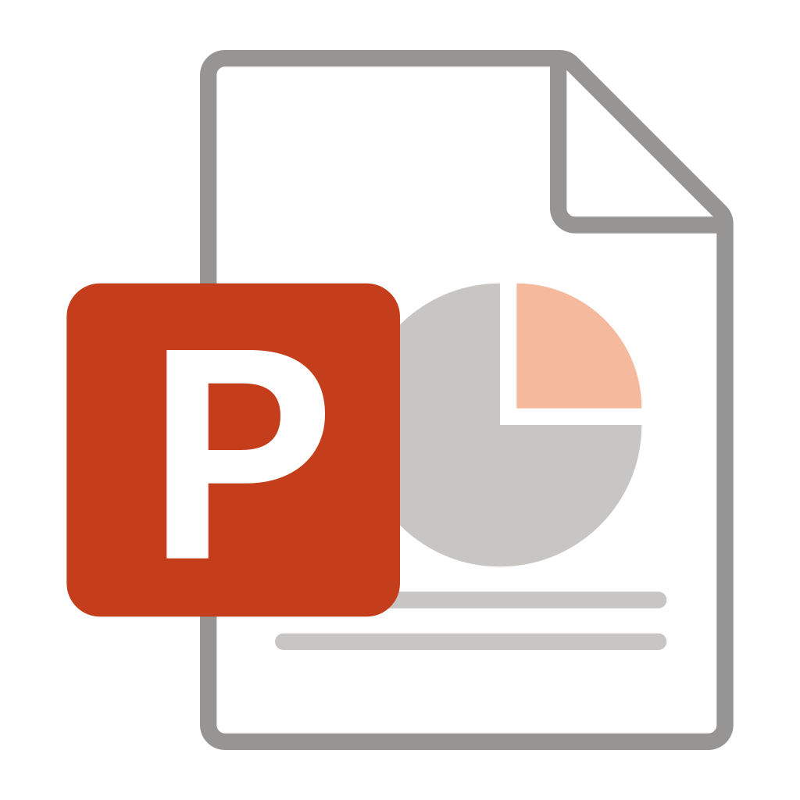


Design and Architecture
VLM Pipeline
Assemble Document
Page images
Build
PDF Pipeline
##
{;}
pdf
Export JSON,
Markdown,
HTML,
Figures,
…
Parse PDF pages
OCR
Layout
Analysis
Table Structure
Assemble Document
images
Build
Docling Document
Simple Pipeline
Create datasets
</>
ascii
md
html
AsciiDoc
Parse Markup Format
Assemble Document
Chunking
for RAG
docx
pptx
xlsx
…
Build
Enrich
Use

Slide 19
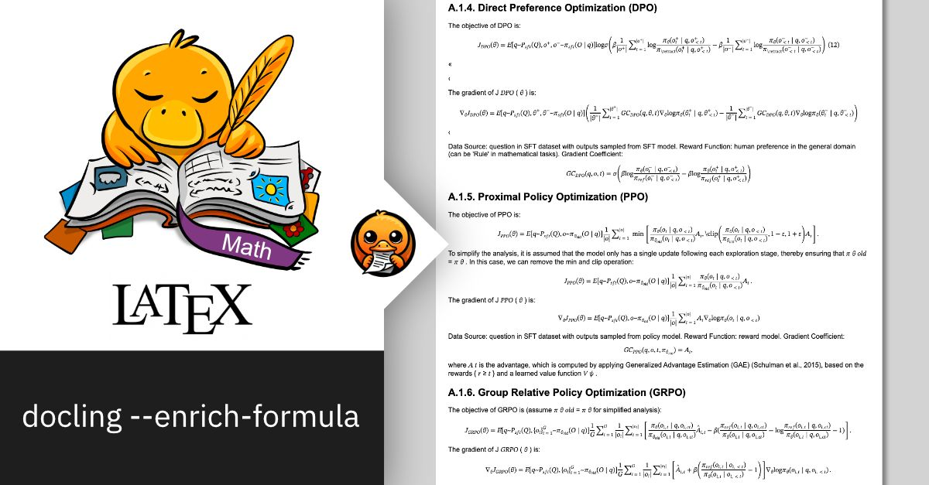

Enrichment models Code and Formula model
Specialized enrichment for Code blocks and Formula
Detection of 50+ programming languages
Extraction of equation formula in LaTeX
https://huggingface.co/ds4sd/CodeFormula

Slide 20
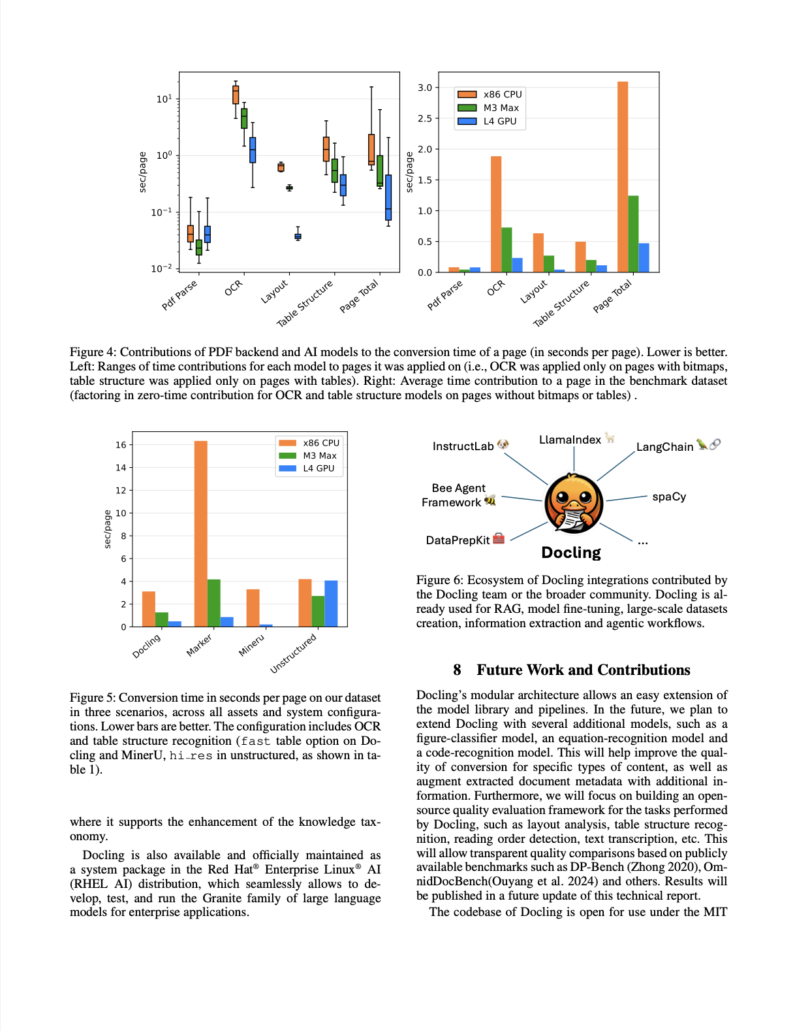
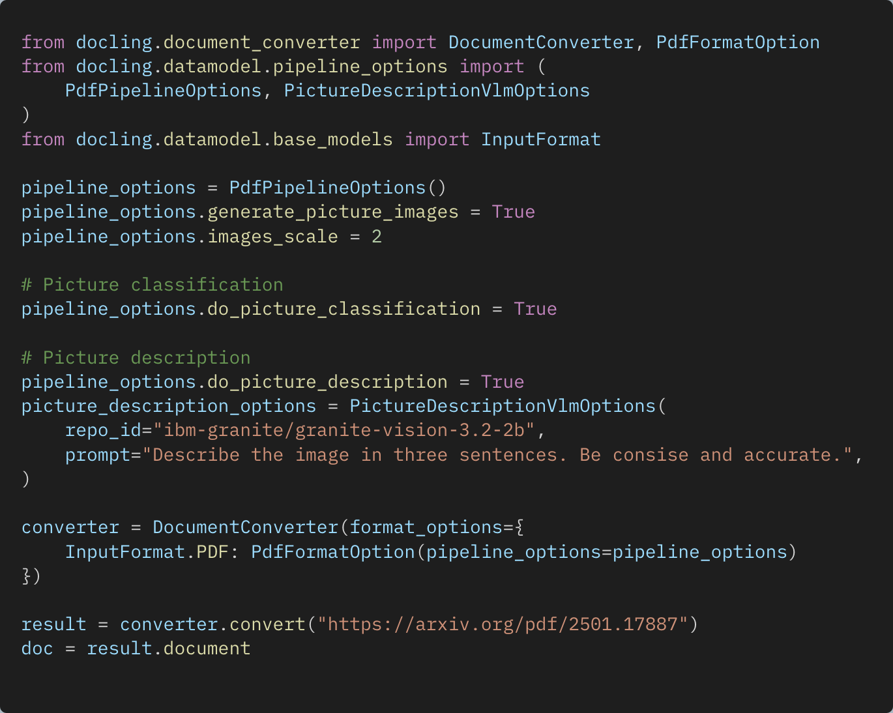
Enrichment models Picture understanding
PictureClassificationClass( class_name='bar_chart’, confidence=0.9999500513076782 )
In this image we can see a bar chart. In the chart we can see the CPU, Max, GPU, and sec/page.
Picture classifier specialized for figures found in documents, e.g. different chart types, flow diagrams, logos, signatures, etc.
Leverage models to create a textual description of the picture

Slide 21
Design and Architecture
VLM Pipeline
Assemble Document
Page images
Build
PDF Pipeline
##
{;}
pdf
Export JSON,
Markdown,
HTML,
Figures,
…
Parse PDF pages
OCR
Layout
Analysis
Table Structure
Assemble Document
images
Build
Docling Document
Simple Pipeline
Create datasets
</>
ascii
md
html
AsciiDoc
Parse Markup Format
Assemble Document
Chunking
for RAG
docx
pptx
xlsx
…
Build
Enrich
Use

Slide 22
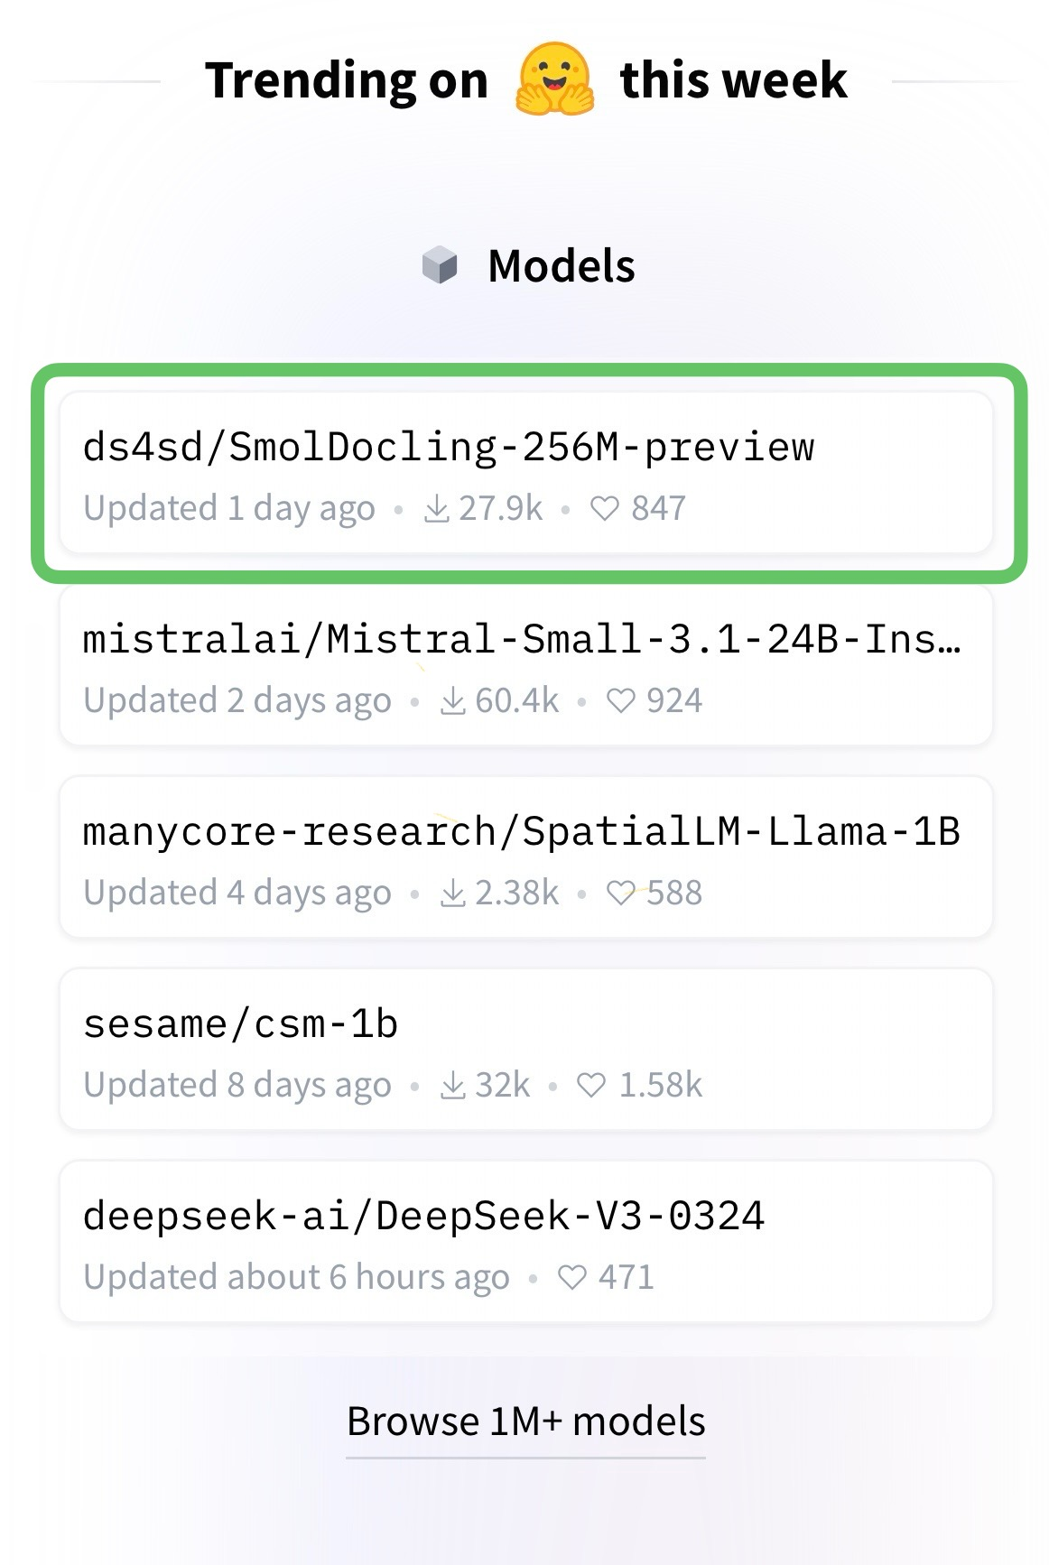
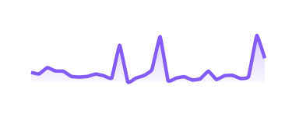
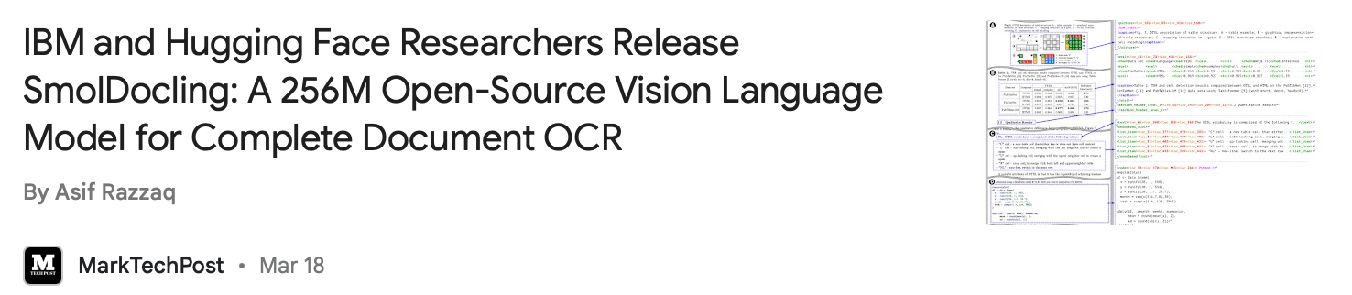
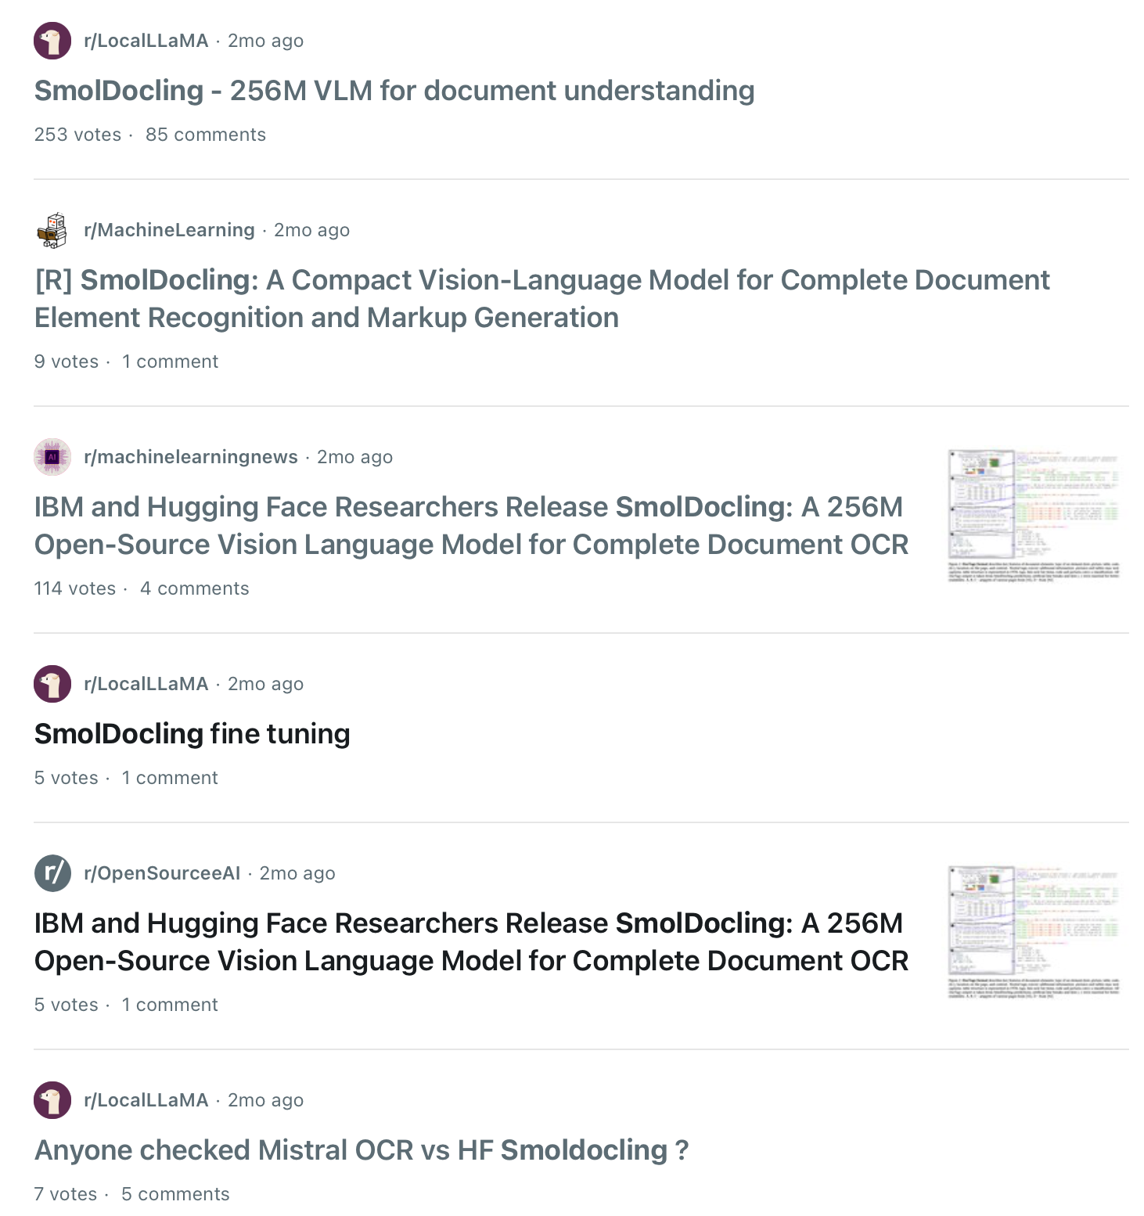


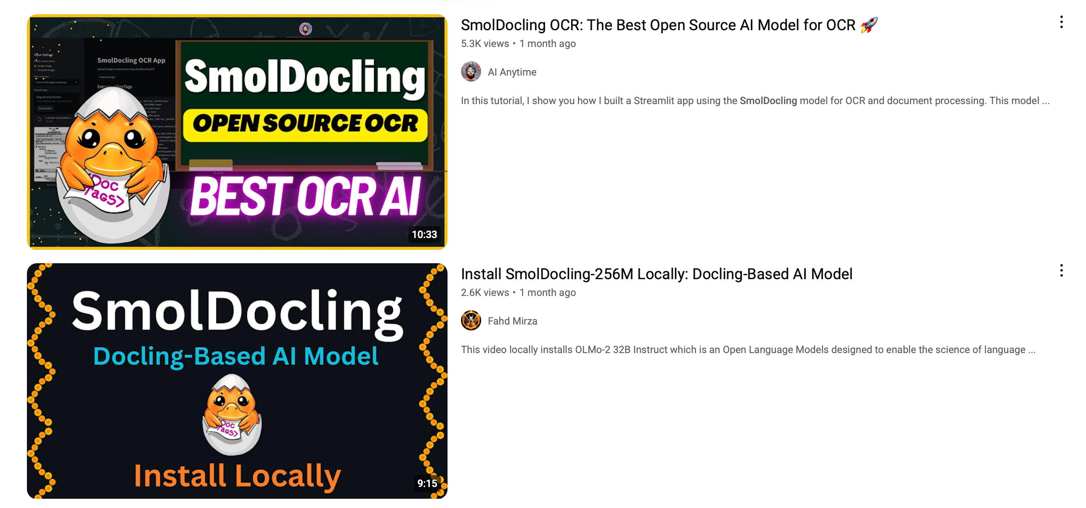
SmolDocling SmolDocling made a strong debut, generating excitement across the document understanding community.
Total downloads
+155k
https://huggingface.co/ds4sd/SmolDocling-256M-preview

Slide 23
SmolDocling Why it works – and why people love it.
🔍 OCR & Bounding Boxes – Accurate text extraction with region-level precision.
🏷️ DocTags – Minimal, efficient, and fully compatible with DoclingDocuments.
📐 Layout Awareness – Preserves structure, positions, and element bounding boxes.
💻 Code, Formula, Figures – Recognizes complex structured content.
📊 Charts & Tables – Parses and reconstructs structured data visually.
📝 Captions, Lists, & Headers– Maintains hierarchy and semantic links.
📄 Full-Page Conversion – Converts complete pages with all content types.
📂 General Document Support – Trained on diverse document types.
⚡ Fast Inference – ~0.35 sec/page on A100 with VLLM.
https://huggingface.co/ds4sd/SmolDocling-256M-preview

Slide 24
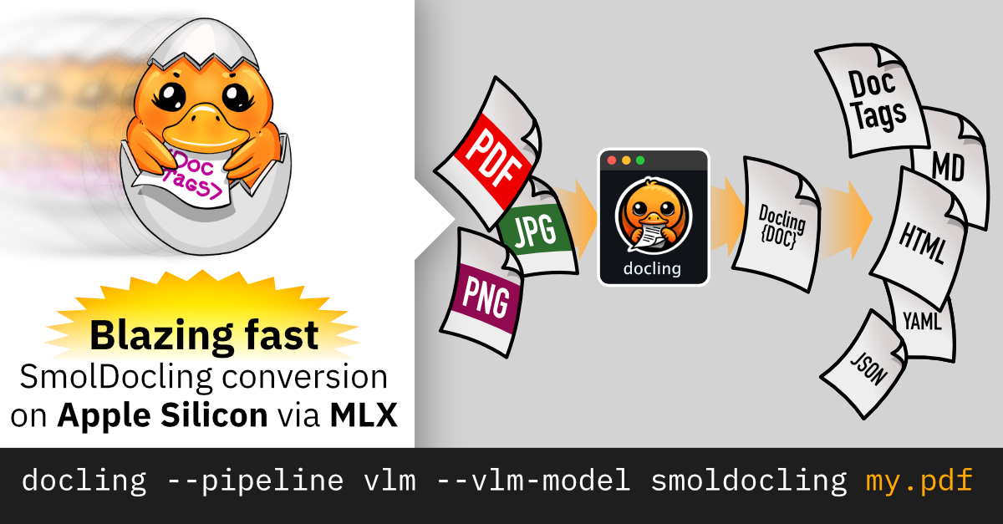
SmolDocling ultra-compact vision-language model for end-to-end document conversion
https://huggingface.co/ds4sd/SmolDocling-256M-preview

Slide 25

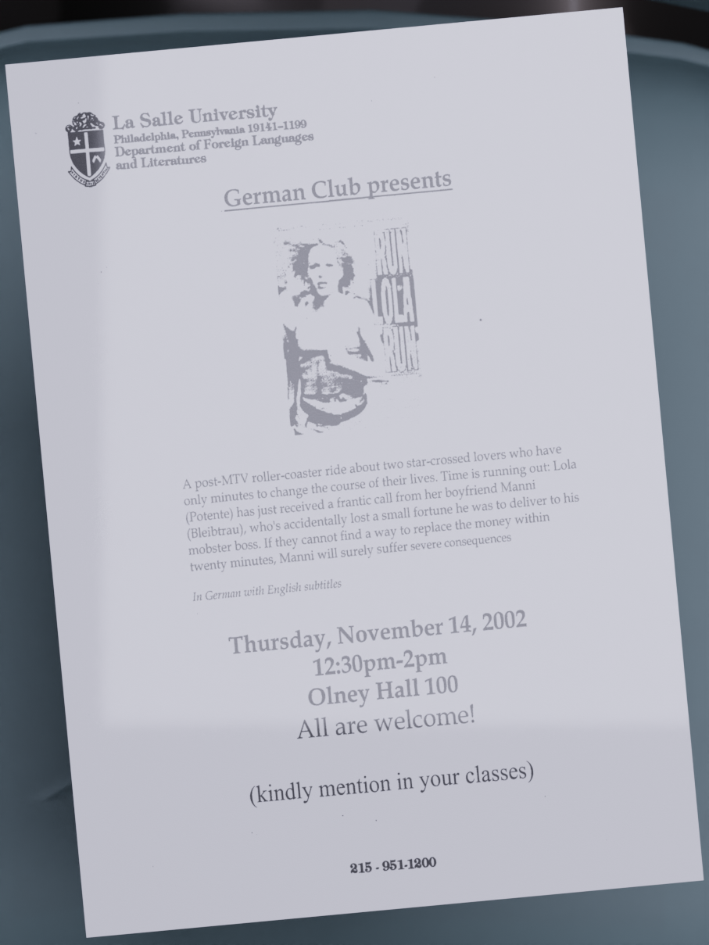
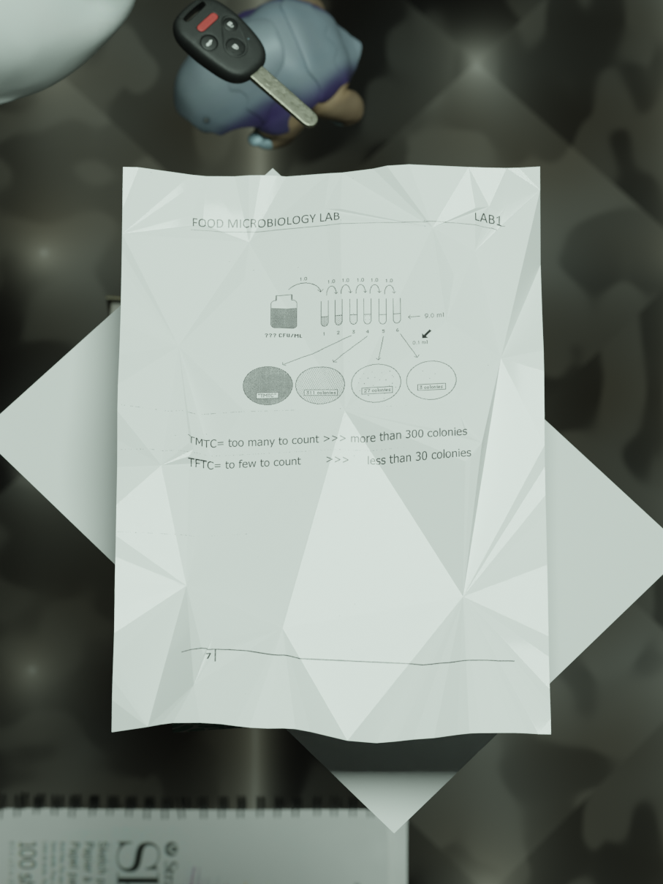
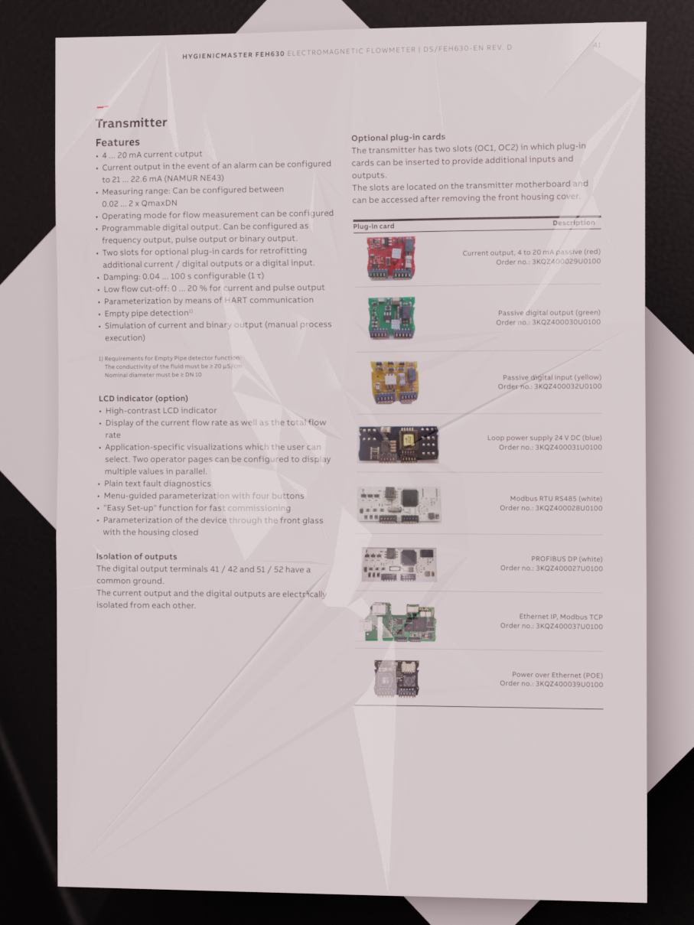
SmolDocling Stay tuned!
🌐 Multi-lingual support: German, Arabic, French, Spanish, Polish, Chinese and Japanese.
📄 DoclingDocument to PDF pipeline.
🧠 Synthetically generate reasoning and CoT datasets for document understanding.
🕵️‍♂️ Text based instruction dataset for understanding DoclingDocuments.
🤖 Synthetically generate documents in the wild.

Slide 26
Design and Architecture
VLM Pipeline
Assemble Document
Page images
Build
PDF Pipeline
##
{;}
pdf
Export JSON,
Markdown,
HTML,
Figures,
…
Parse PDF pages
OCR
Layout
Analysis
Table Structure
Assemble Document
images
Build
Docling Document
Simple Pipeline
Create datasets
</>
ascii
md
html
AsciiDoc
Parse Markup Format
Assemble Document
Chunking
for RAG
docx
pptx
xlsx
…
Build
Enrich
Use

Slide 27
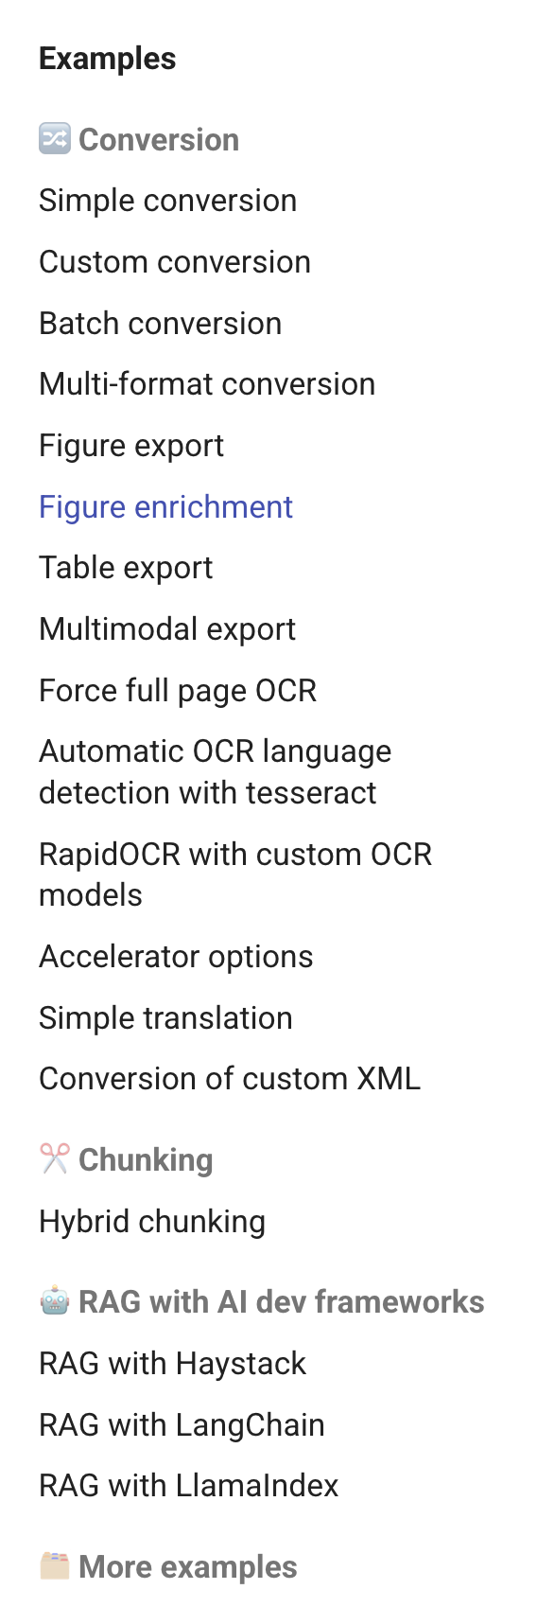
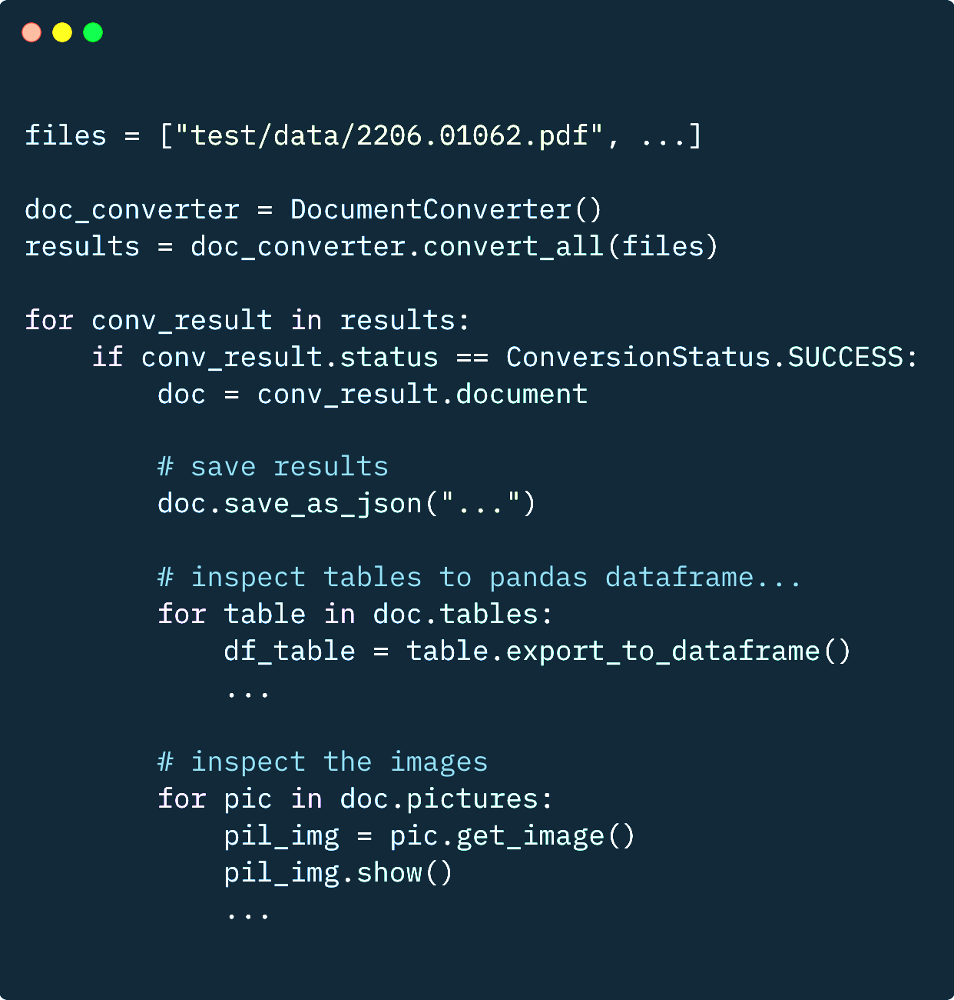
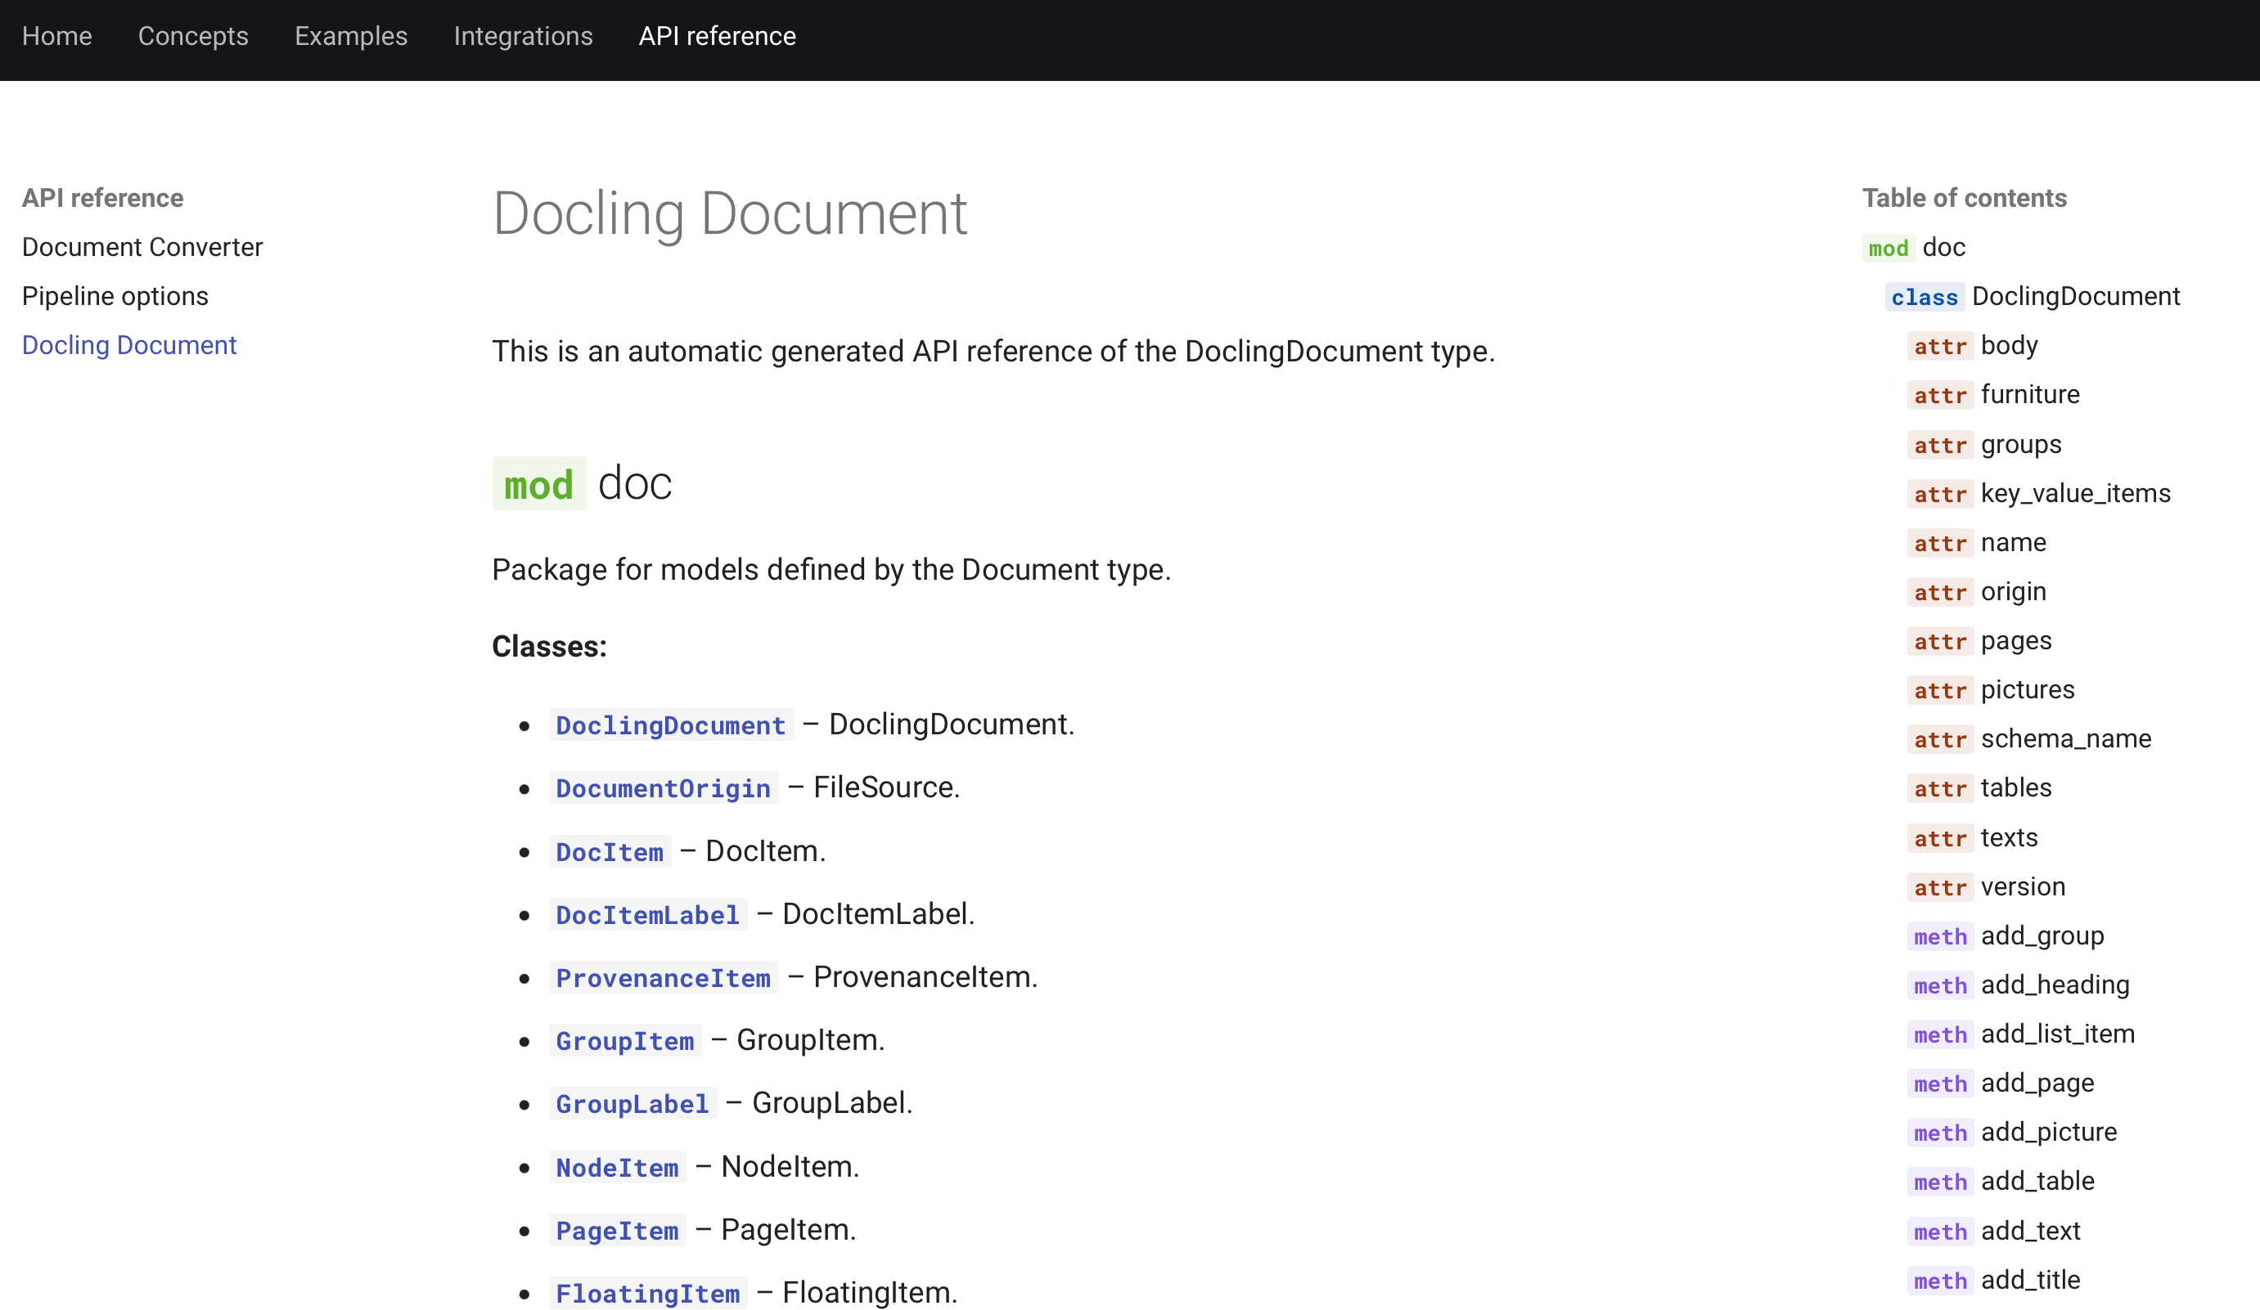
Docling is for developers!
Full-fledged SDK to inspect document content
APIs to transform content to various formats and representations
Tons of usage examples and notebooks
Carefully designed DoclingDocument data model
Notes:
Docling is not an opaque command-line tool, it is really built for developers

Slide 28
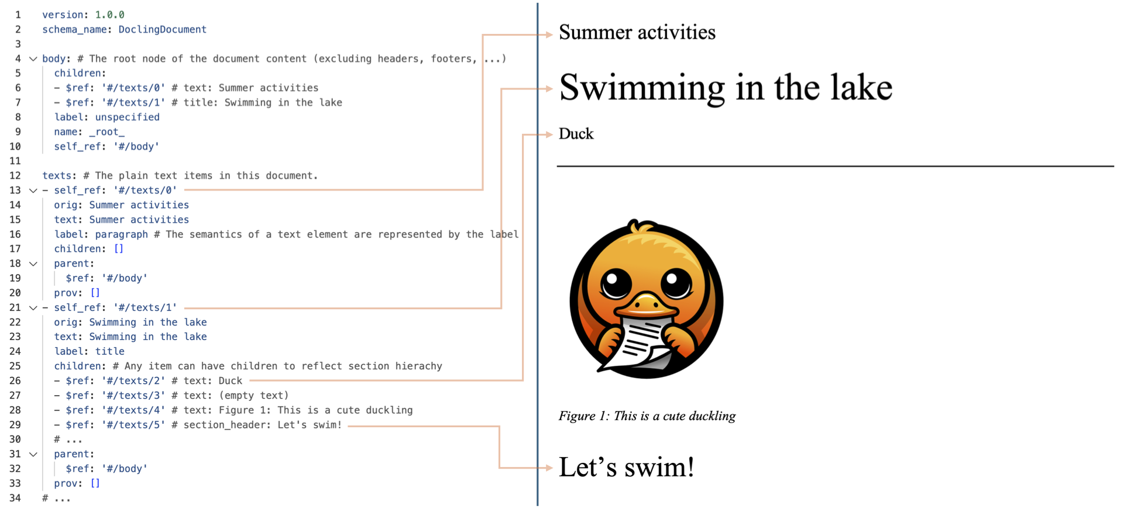
DoclingDocument data model
##
{;}
Export JSON,
Markdown,
HTML,
…
Docling Document
Create datasets
Chunking
for RAG
…
Enrich
Use
Notes:
Rich representation of content features, no matter from which source format
Text, Tables, Pictures, and more
Document hierarchy with sections and groups
Disambiguation between main body and headers, footers (furniture)
Layout information (i.e. bounding boxes) for all items, if available
Annotations and metadata
Store DoclingDocument as JSON to preserve full fidelity, transform it to any other representation (e.g. Markdown) when required.
Only requires minimal dependencies.

Slide 29
Serialization
Markdown (flavor A)
Markdown (flavor B)
...
Derive any type of text export from a DoclingDocument
Built-in serializers for Markdown, HTML, and more
Easily customize — or plug in user-provided serializers
Multimodal capabilities tailored to user needs
E.g. picture serialization
Docs: https://docling-project.github.io/docling/concepts/serialization/
Hands-on examples: https://docling-project.github.io/docling/examples/serialization/
...
HTML (flavor A)
Docling Document
HTML (flavor B)
...
DocTags (flavor B)
DocTags (flavor A)
...

Slide 30
Chunking
Fixed-size
Semantic
Splitting documents in meaningful parts
Significant part of RAG as directly affects retrieval
Various strategies one can consider
Semantic
Recursive
Doc structure-based
LLM-based
...

Slide 31
Chunking
Chunk 1
Chunk 2
Docling supports different strategies via built-in chunkers & extensible design that allows plugging in user-defined ones
All native on rich DoclingDocument level, not just text
Hierarchical: based on the doc layout extracted by Docling
Hybrid: combines doc layout and tokenization awareness
Any built-in or user-defined serializer can be used
Docs: https://docling-project.github.io/docling/concepts/chunking/
Examples: https://docling-project.github.io/docling/examples/hybrid_chunking/
Chunk 3
Chunk 4
Chunk 5
Hybrid chunking captures both document layout and token limitations

Slide 32
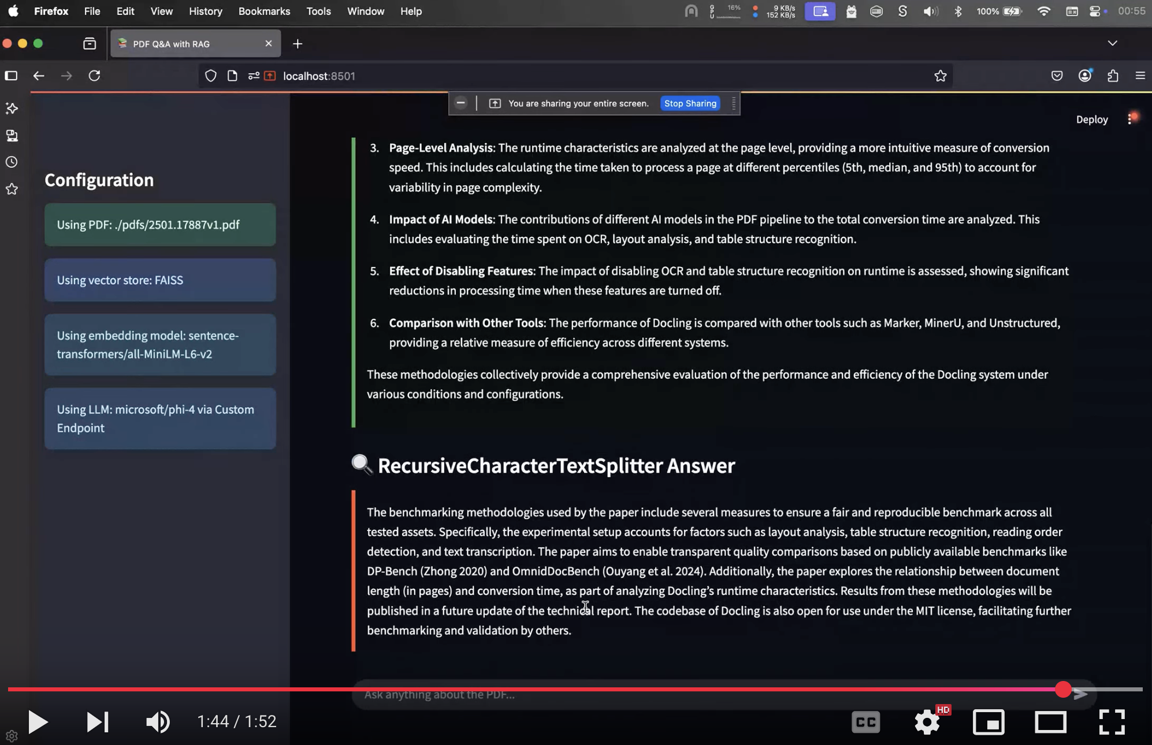
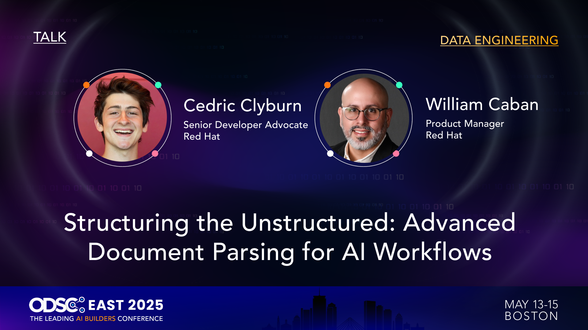
Impact of Chunker
Code Repository https://github.com/williamcaban/odsc-east-2025 Video https://youtu.be/dNMu5iZR70Q

Slide 33
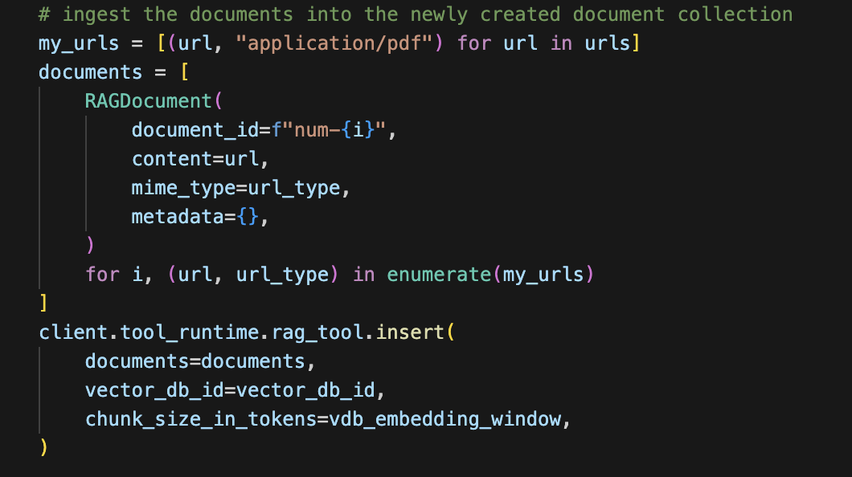

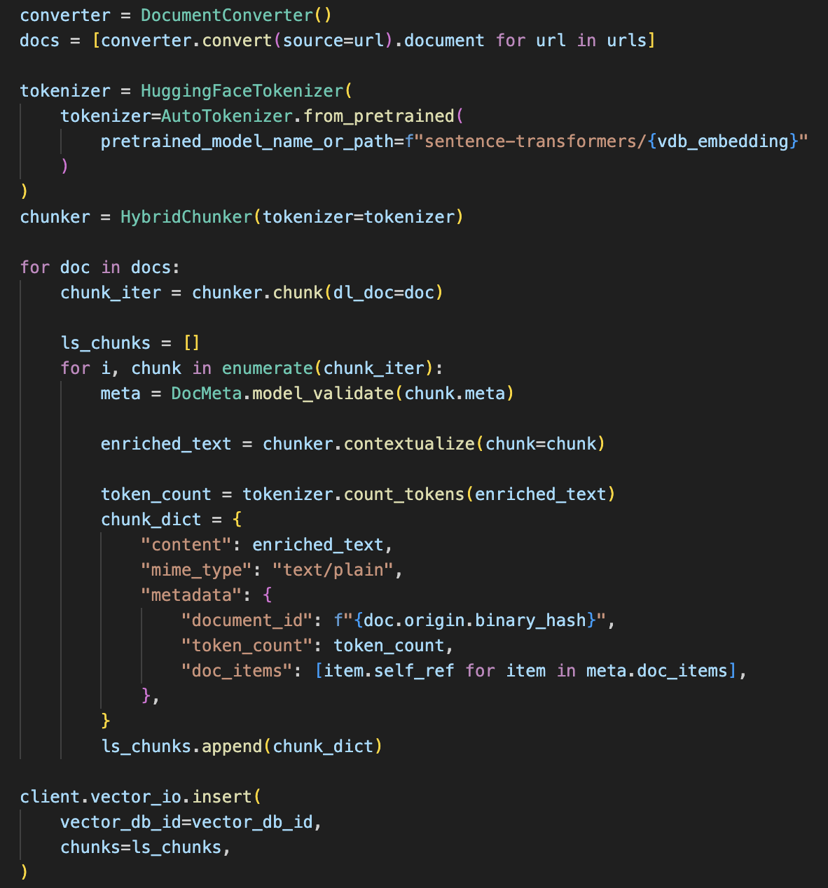
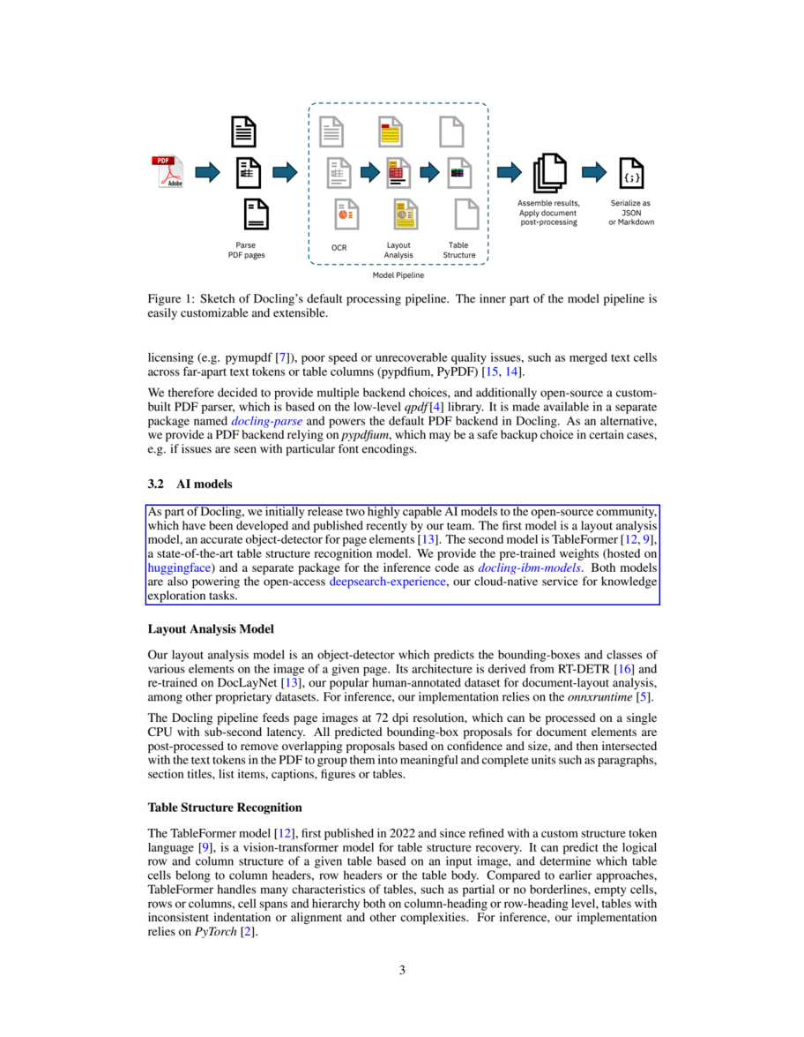
Llama Stack RAG with Docling
Enhance the Llama Stack RAG with:
Amazing document conversion (it does a difference!)
RAG on complex document components (tables, etc)
Multi-modal RAG
Visual grounding
🤝
https://github.com/trustyai-explainability/ai-masterclass-2025

Slide 34
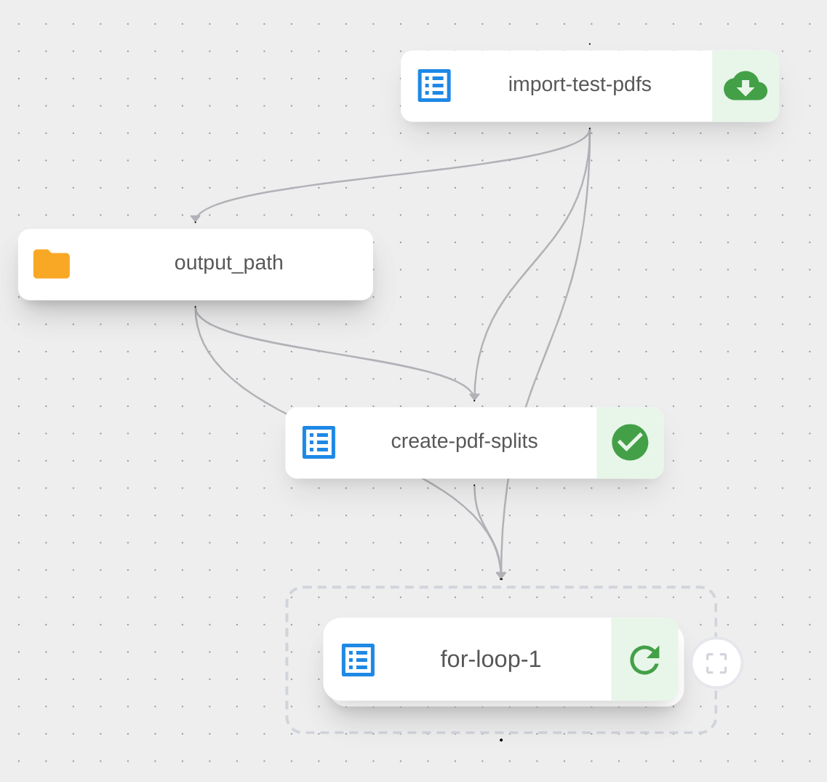

What is next? Docling large scale jobs
throughput
Scale, scale, scale!
Scale out to thousands of cores
Support for multiple gpus
Orchestrate conversion and enrichment steps (e.g. industry verticals)
Telemetry and seamless monitoring of large jobs
Built on OpenShift AI tools
Duck-power
https://github.com/docling-project/docling-jobkit

Slide 35

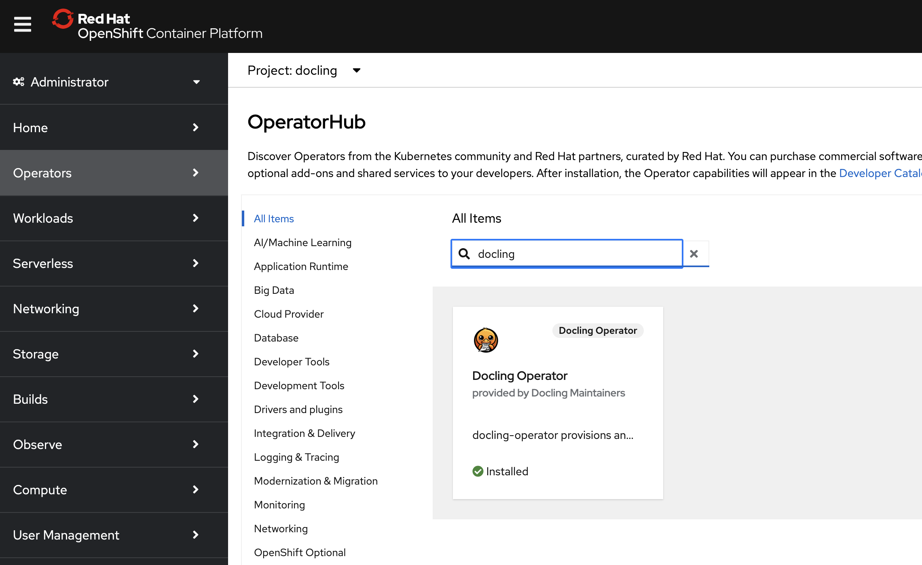




What is next? Docling Serve on OpenShift
A strong collaboration with
Doc-level highly parallel
Use cloud-storage connectors
Heavy
Distribute via Kubeflow
k8s api
(Remote queue + Workers)
No k8s req
No doc-level parallel
Light and simple
Docling JobKit - KFP
Local queue processing
Docling Serve
{ } rest api

Slide 36

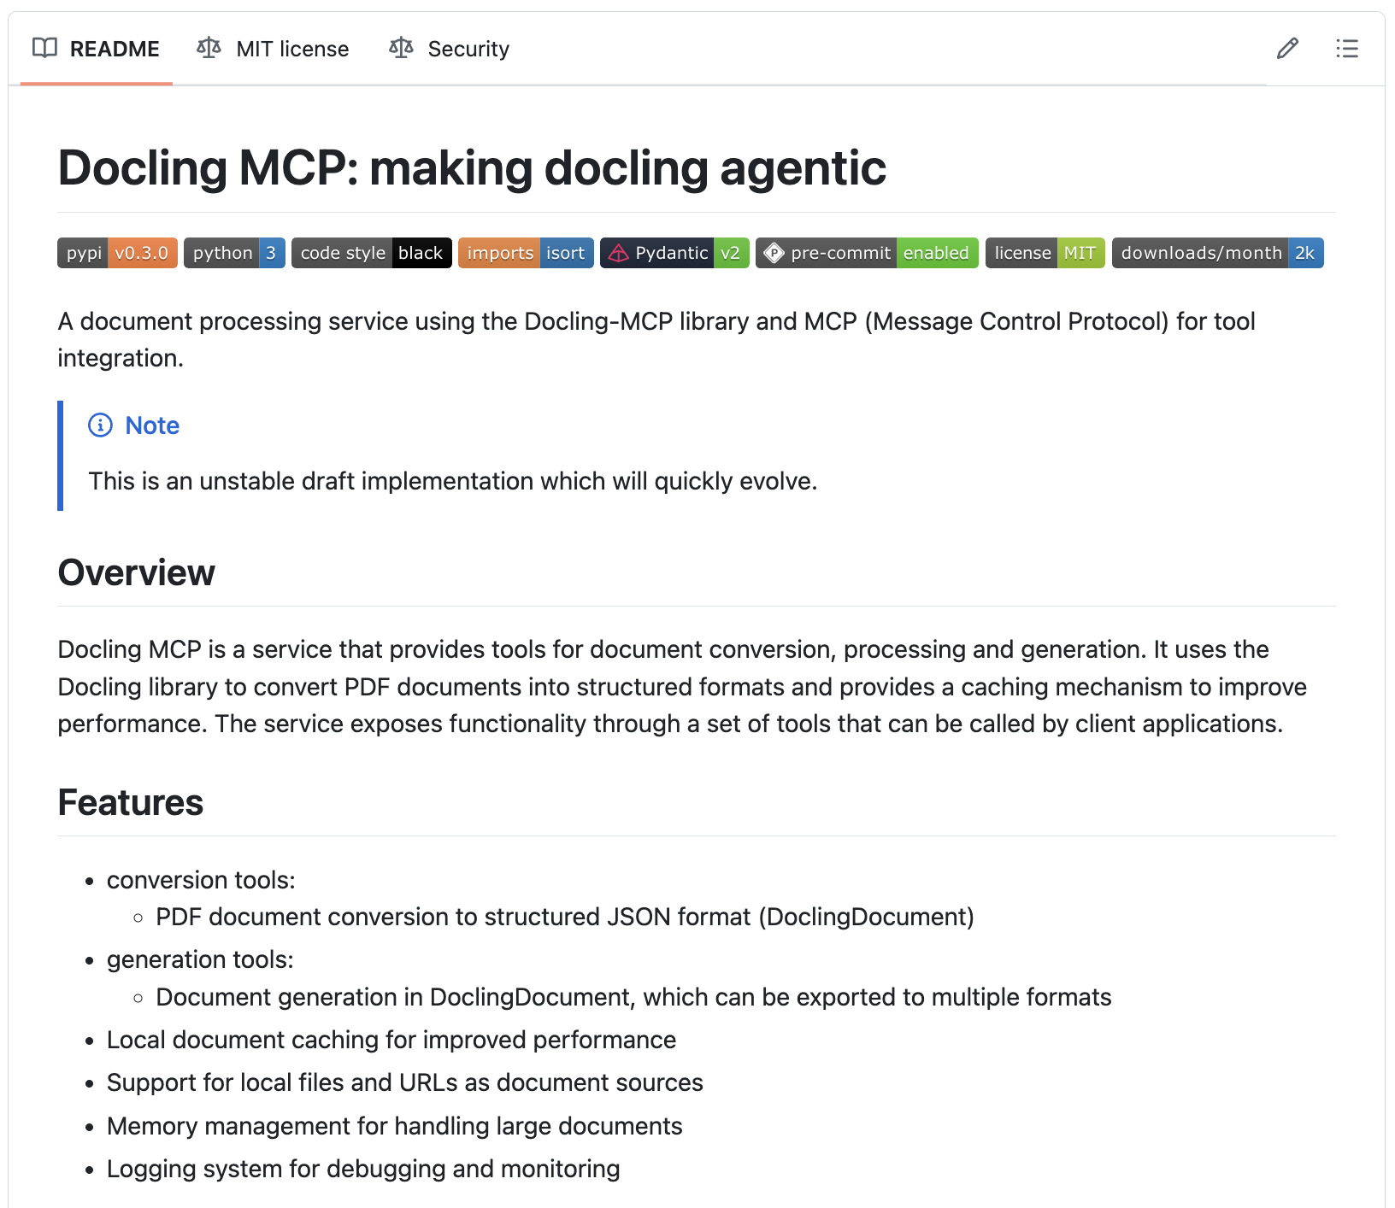

What is next? Make Docling agentic!

Slide 37

Docling
Try it out!
🔗 GitHub: github.com/docling-project 📦 Install: pip install docling 📚 Tech paper: arxiv.org/abs/2501.17887
Join us tomorrow!
Docling Meetup 📅 Tuesday, May 20th, 6pm 📍 Location: MIT-IBM Watson AI Lab in Cambridge
Registration: https://ibm.biz/DoclingCommunity
💻 Use it, ⭐ star it, 🚀 spread the word about Docling!

